Slide 1
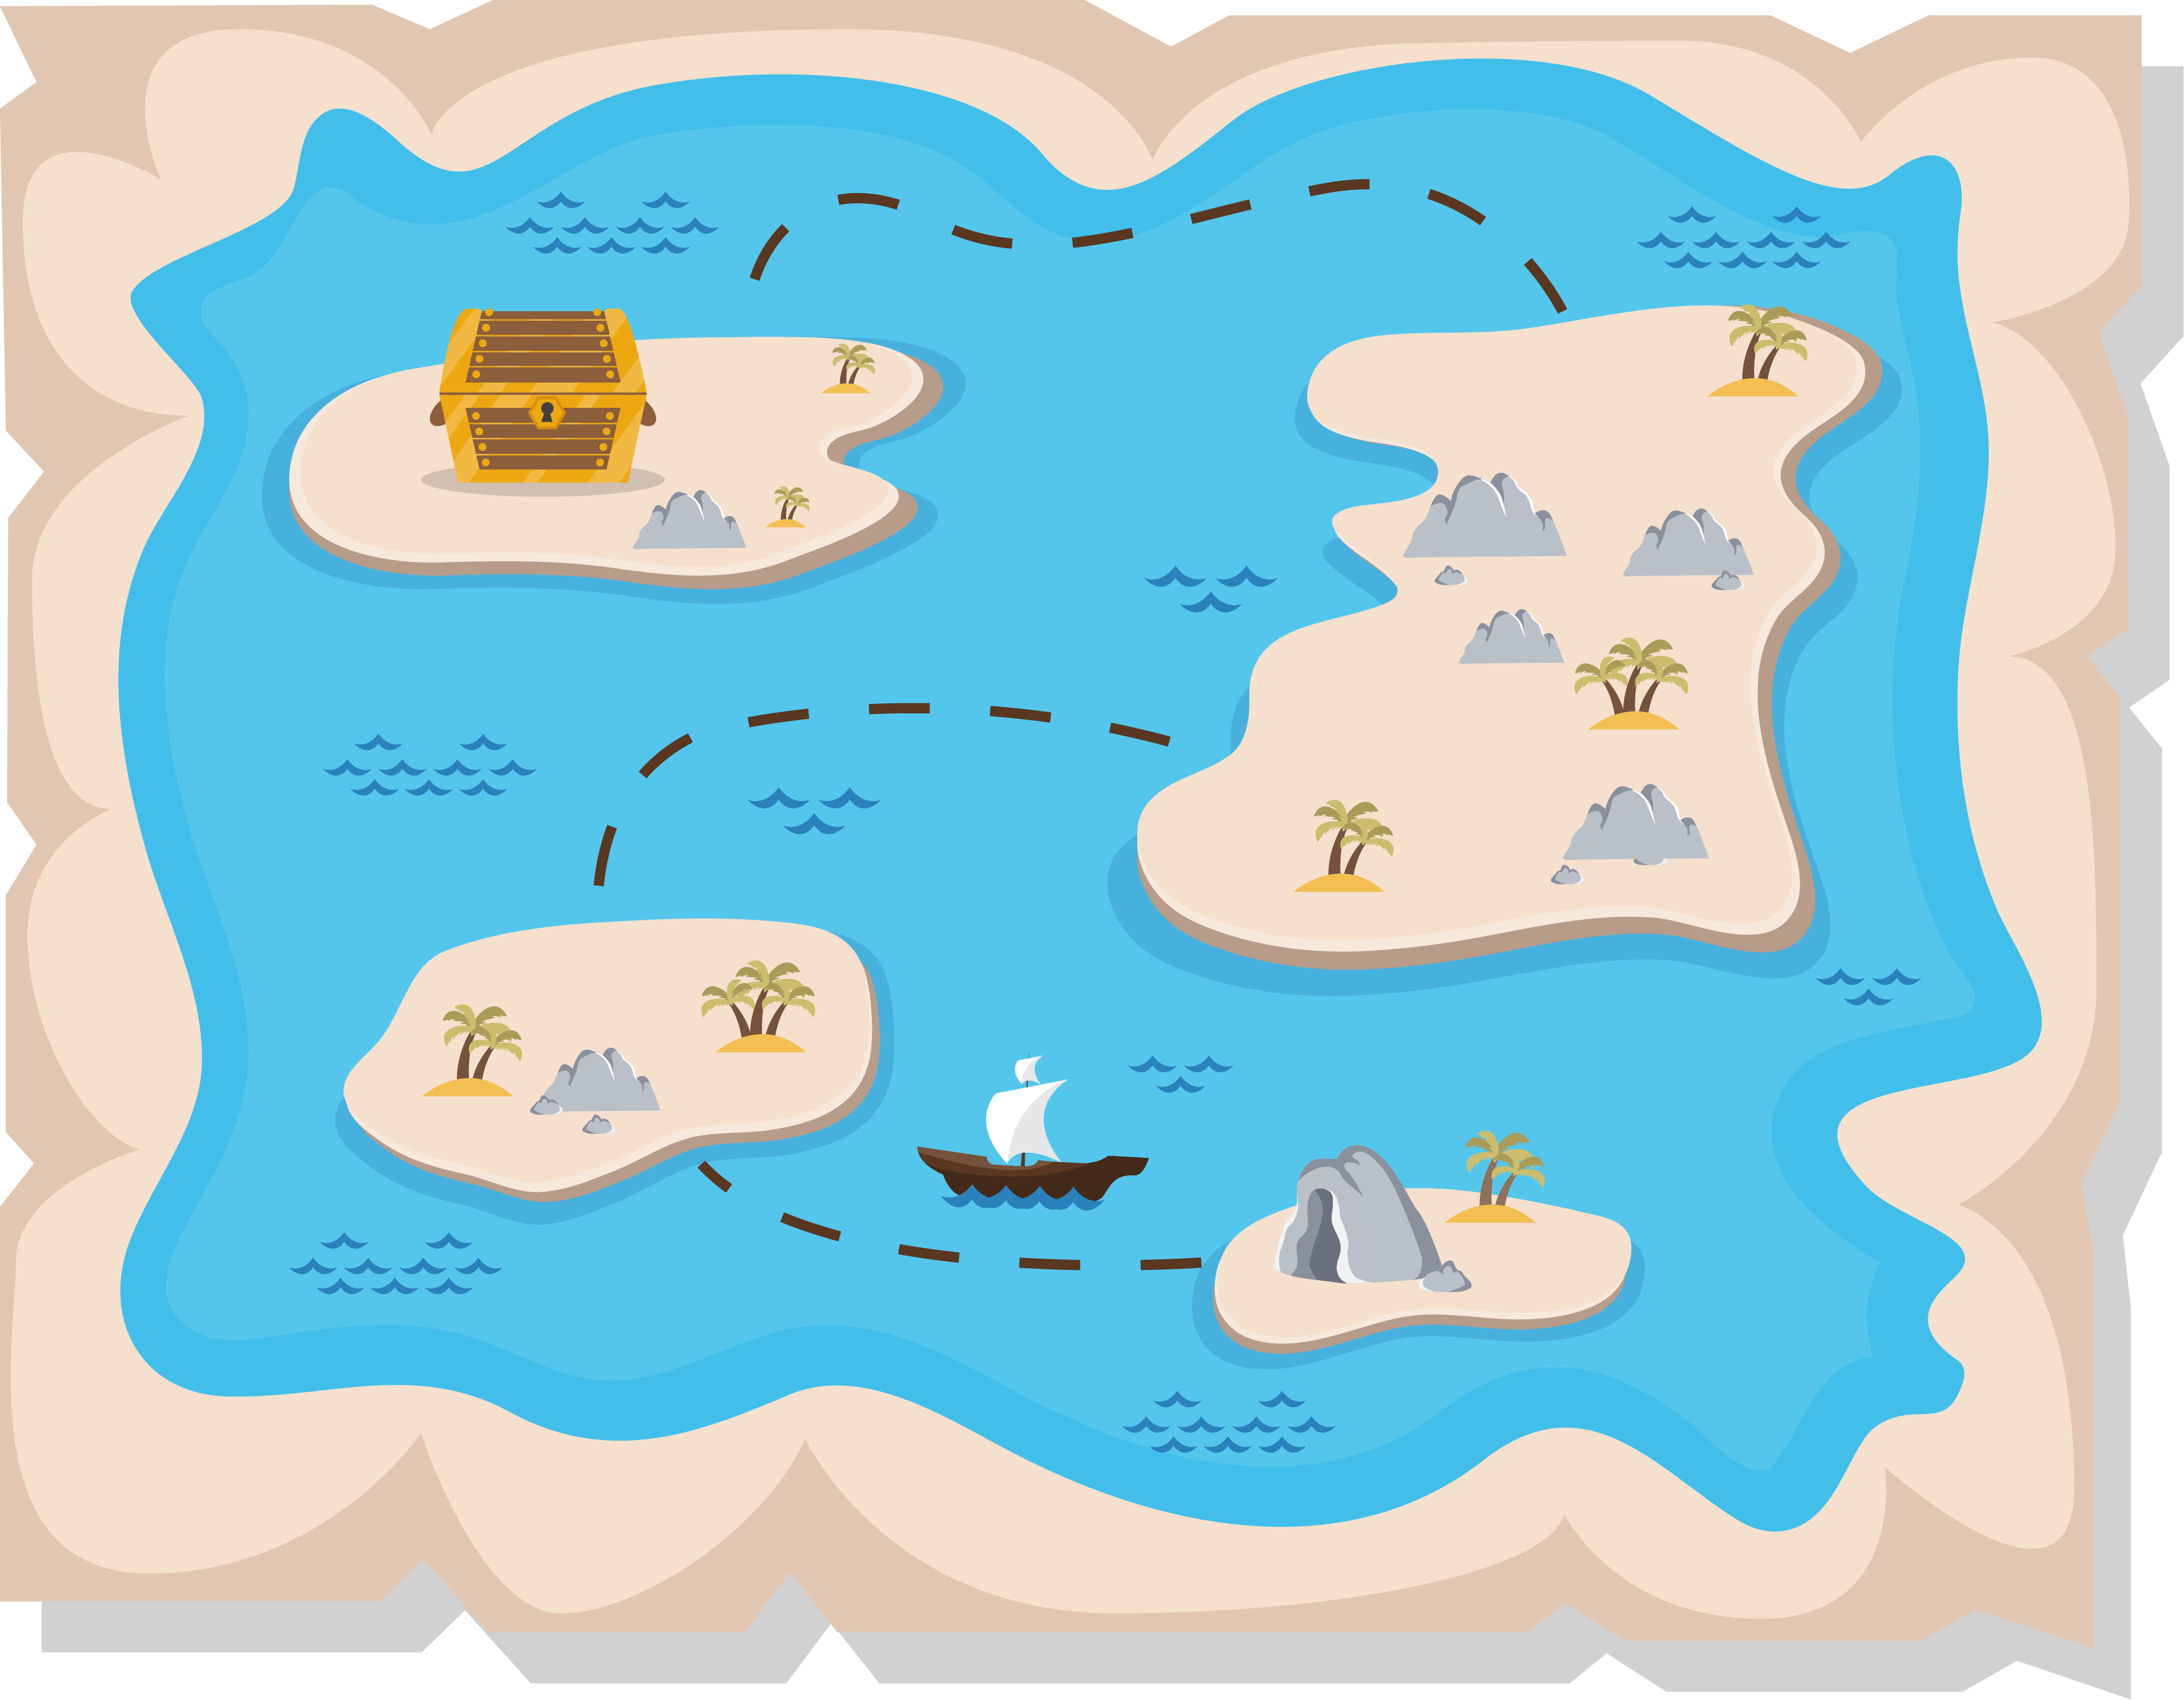
Lesson 2:
Treasure Hunt

Slide 2
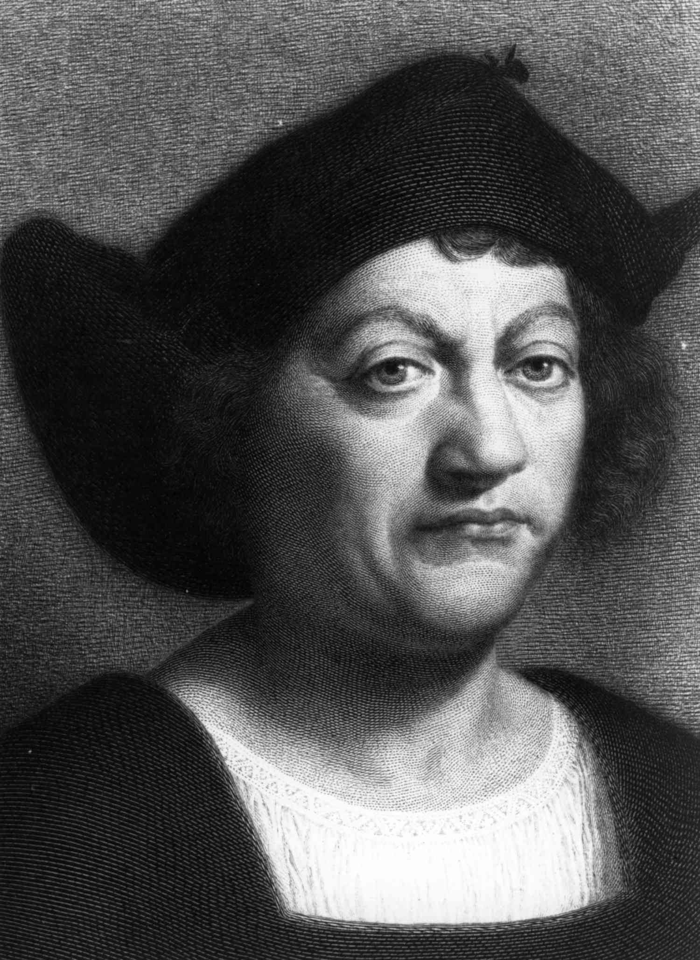
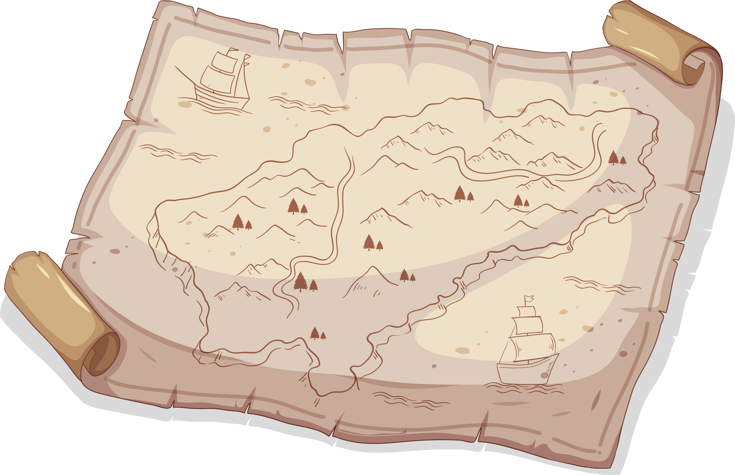
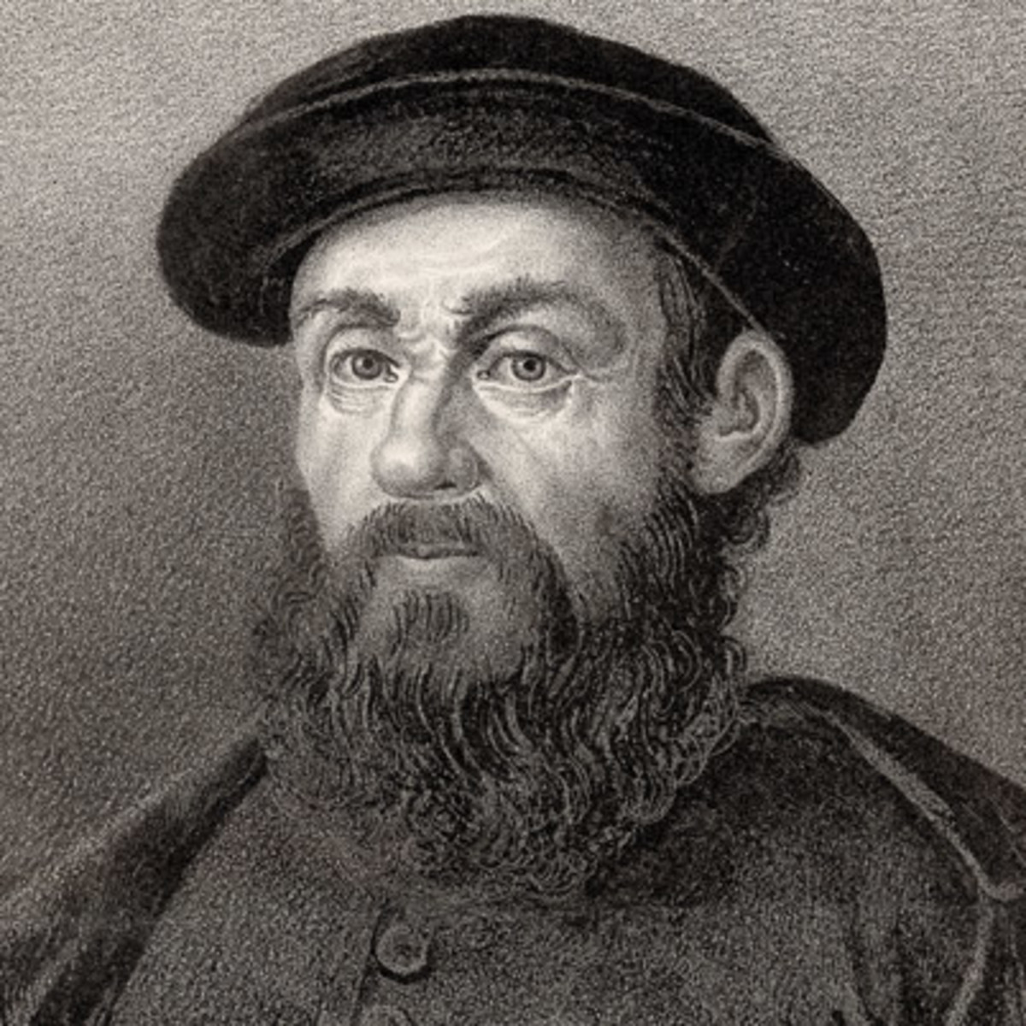
Maritime Exploration
Ferdinand Magellan
Christopher Columbus

Slide 3
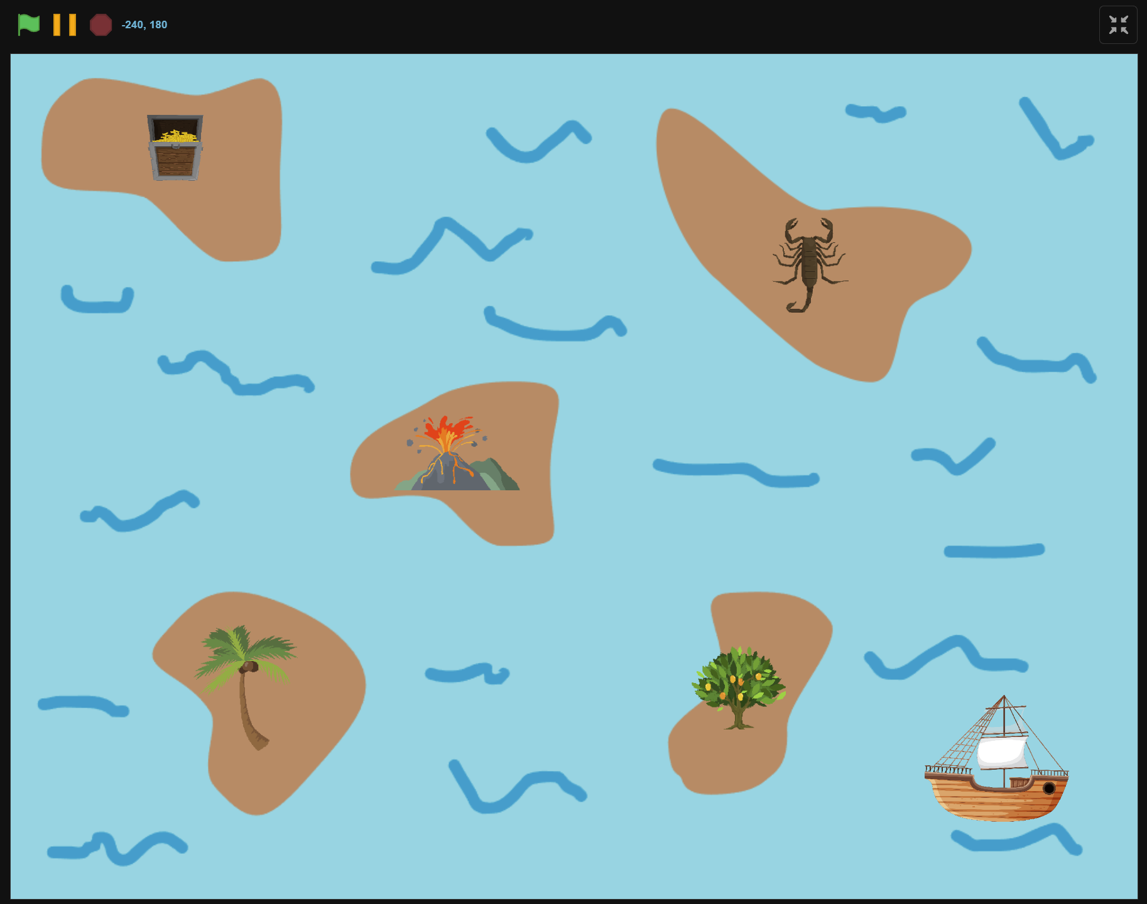
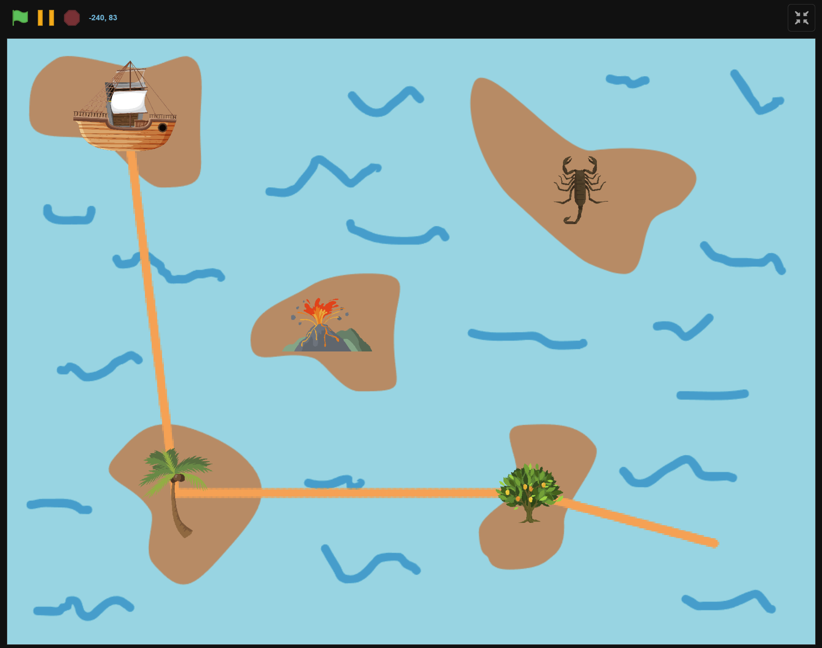
What we will Create…

Slide 4
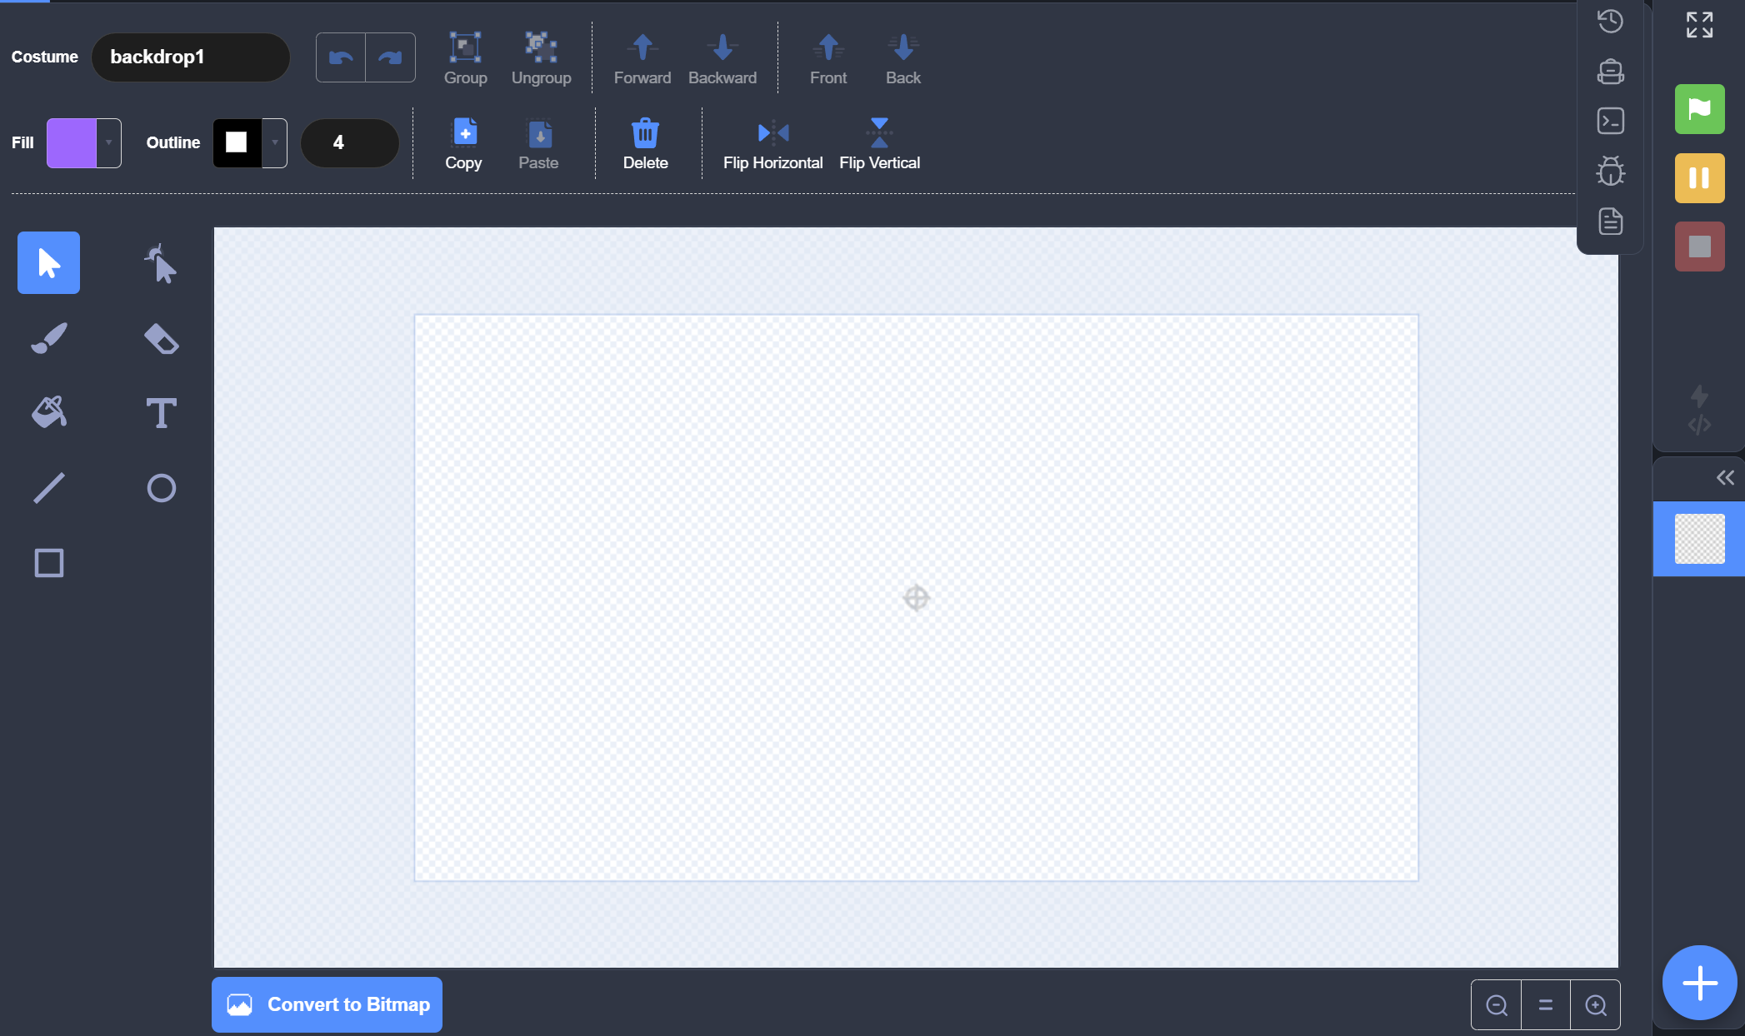
Backdrop editor

Slide 5
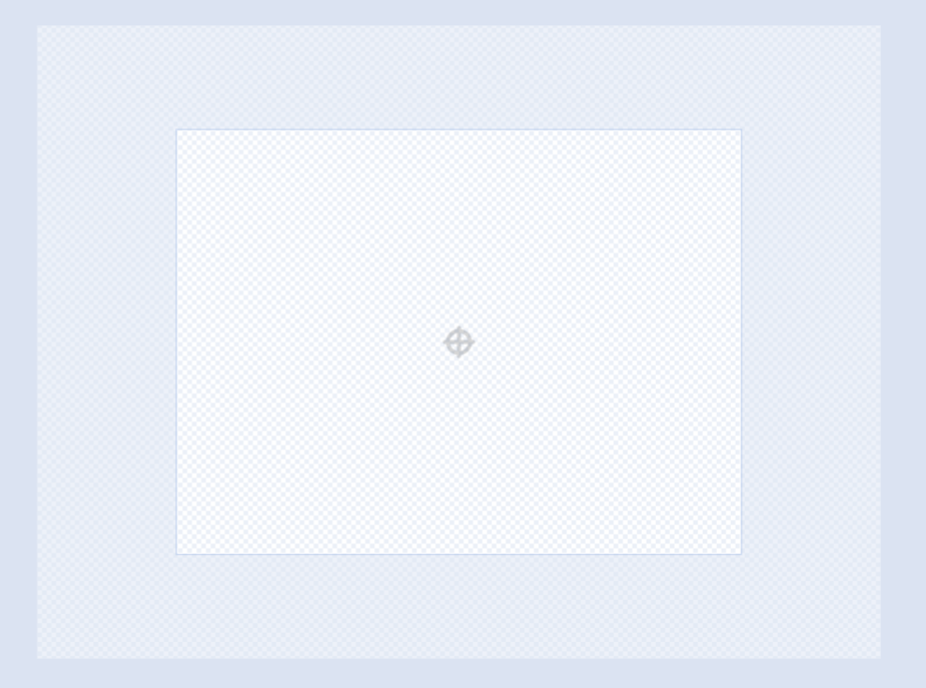

Canvas
Outside of stage
Stage
Change Canvas Size

Slide 6
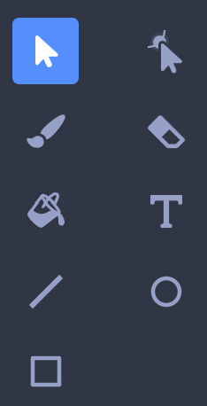
Tool Box
Select
Reshape
Brush
Eraser
Fill
Text
Line
Circle
Rectangle

Slide 7
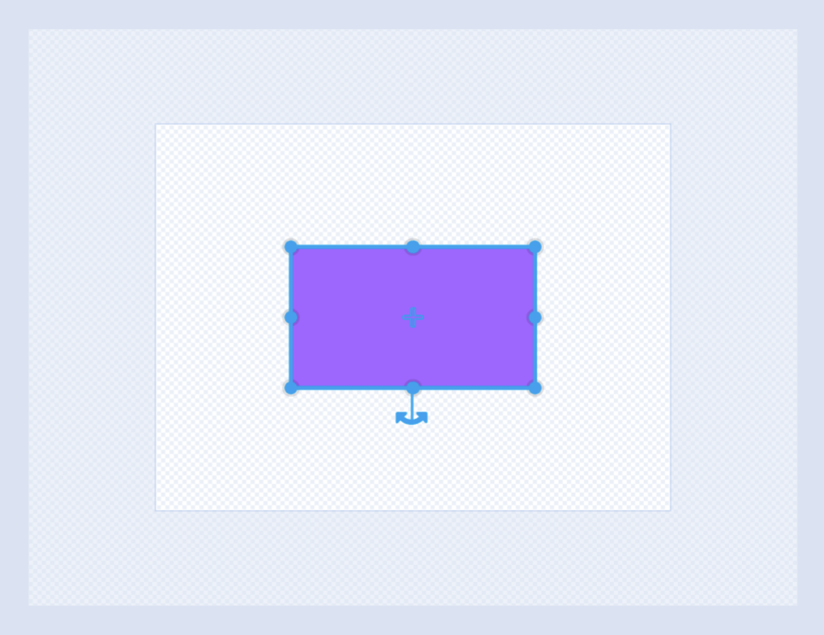
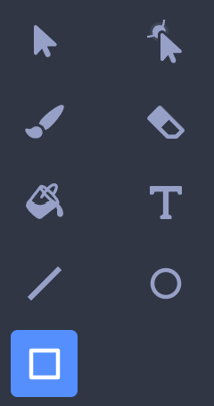
Draw Rectangle
Change Height
Change Width
Change Height and Width
Rotate
Rectangle

Slide 8
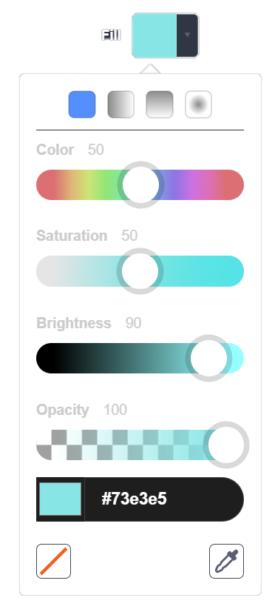
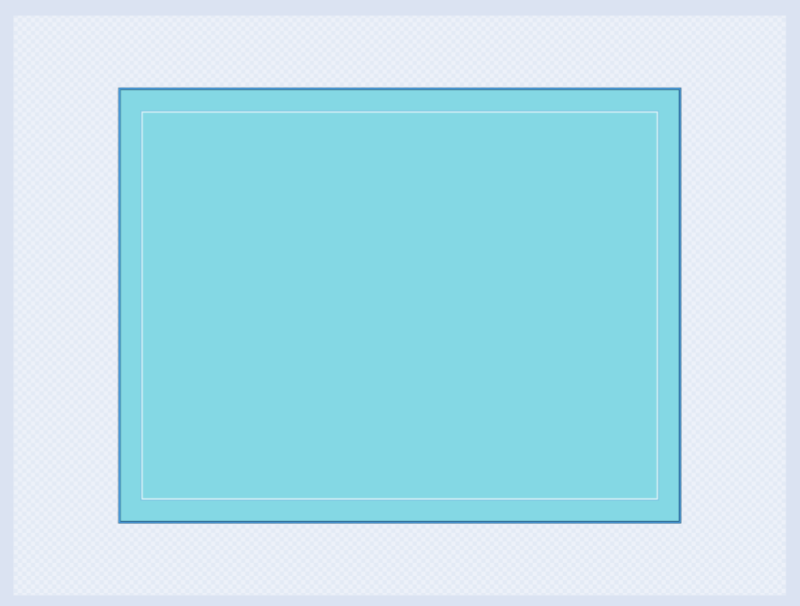
Draw Ocean
Color: 50
Saturation: 50
Brightness: 90
Opacity: 100

Slide 9
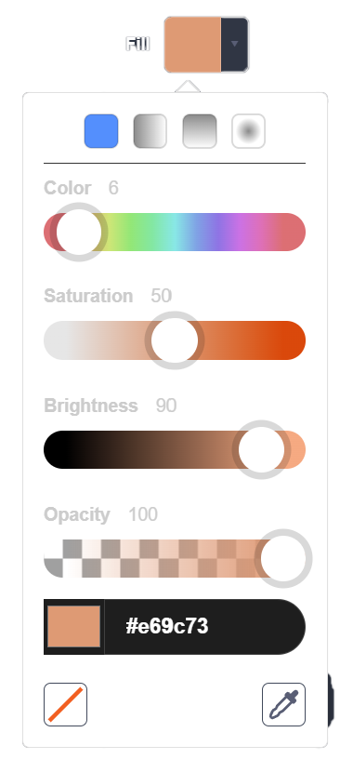
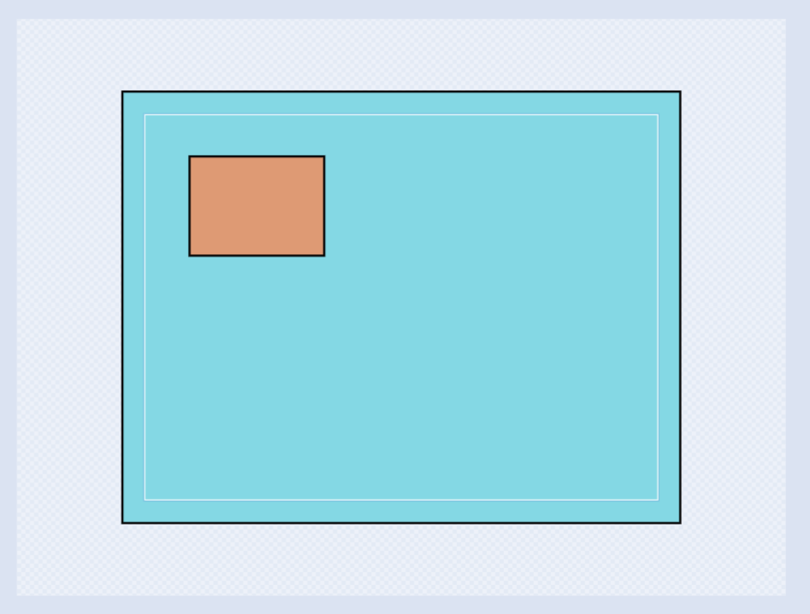
Draw Island
Color: 6
Saturation: 50
Brightness: 90
Opacity: 100

Slide 10
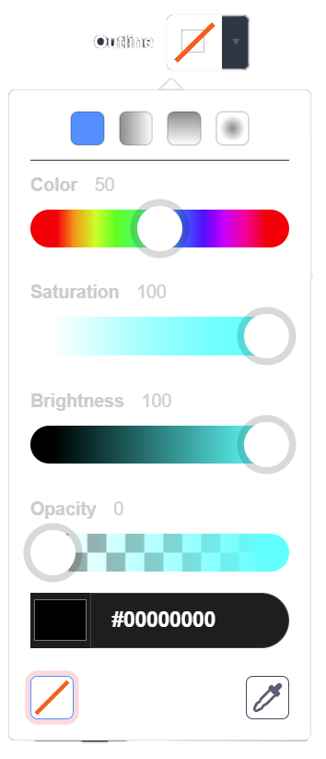
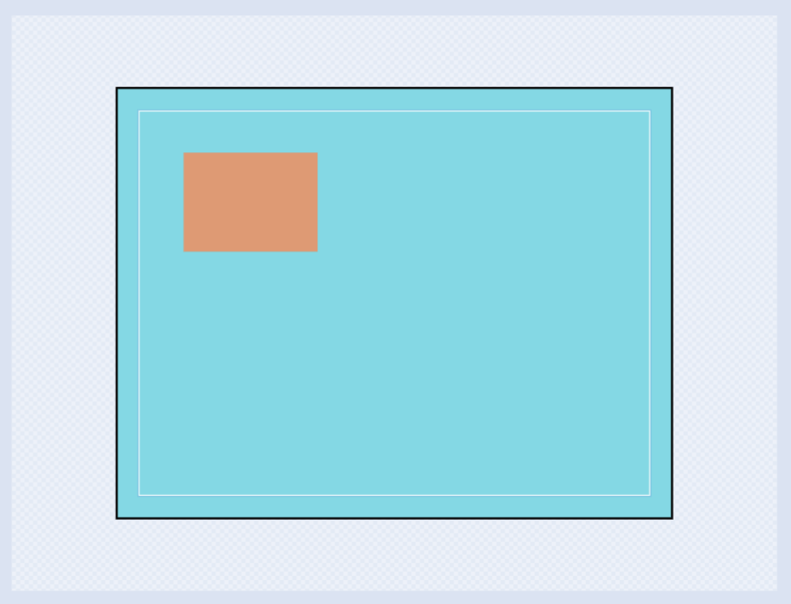
Remove outline
Remove Outline

Slide 11
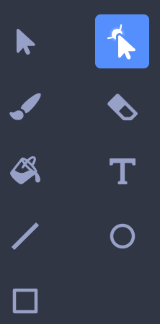
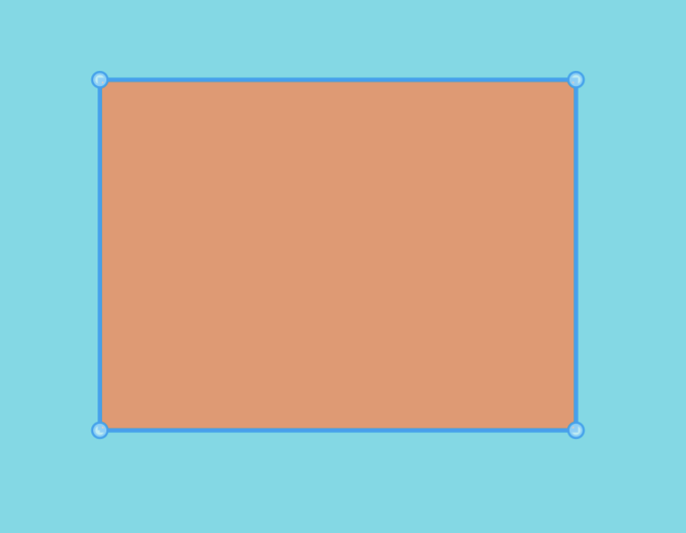
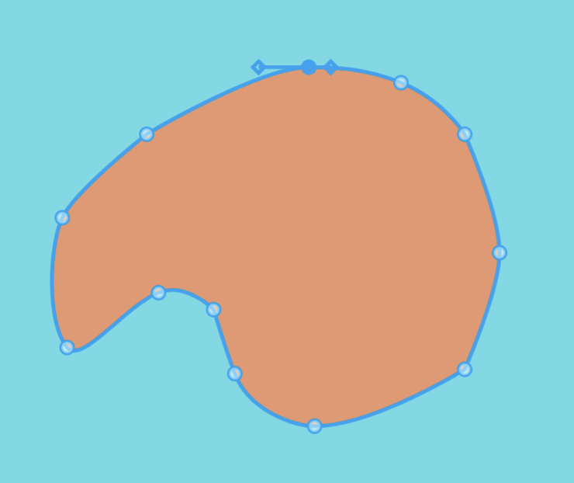
Reshape island

Slide 12
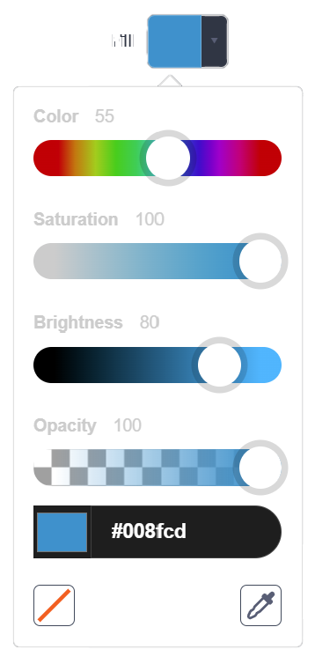
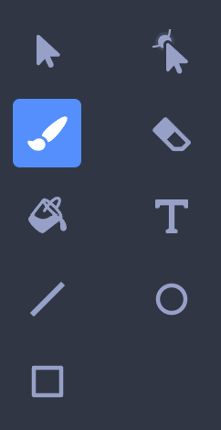

Draw Waves
Color: 55
Saturation: 100
Brightness: 80
Opacity: 100

Slide 13
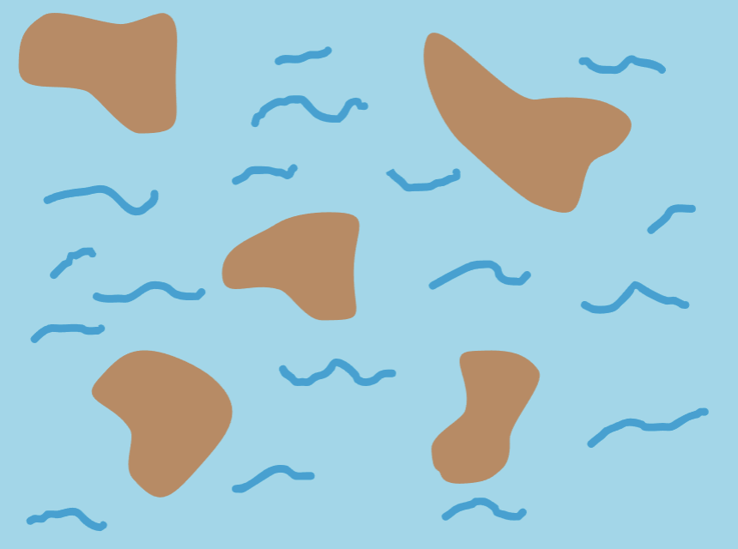
Finished backdrop

Slide 14
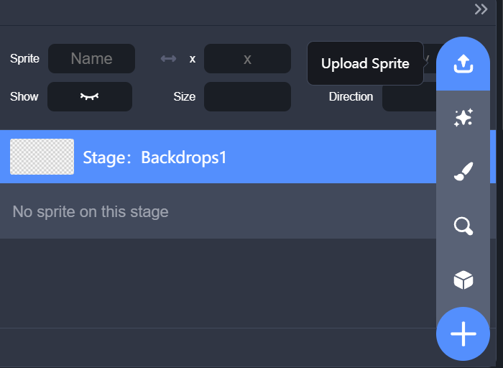
Upload Treasure Sprite

Slide 15
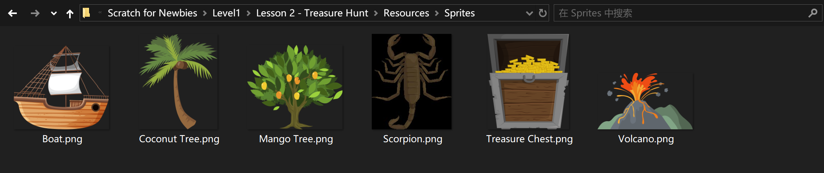
Upload Treasure Sprite

Slide 16
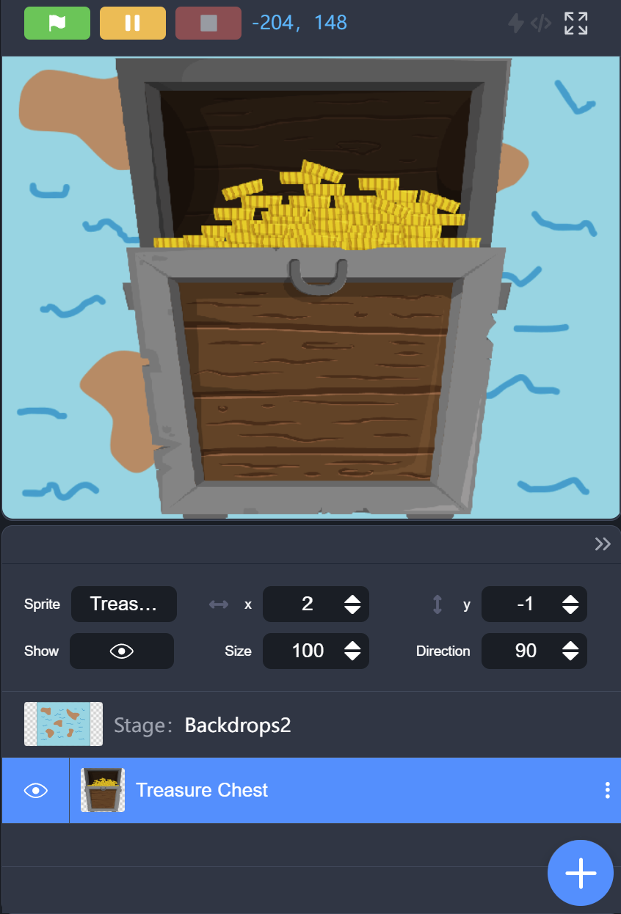
Treasure is Too Big
Too big!!!

Slide 17
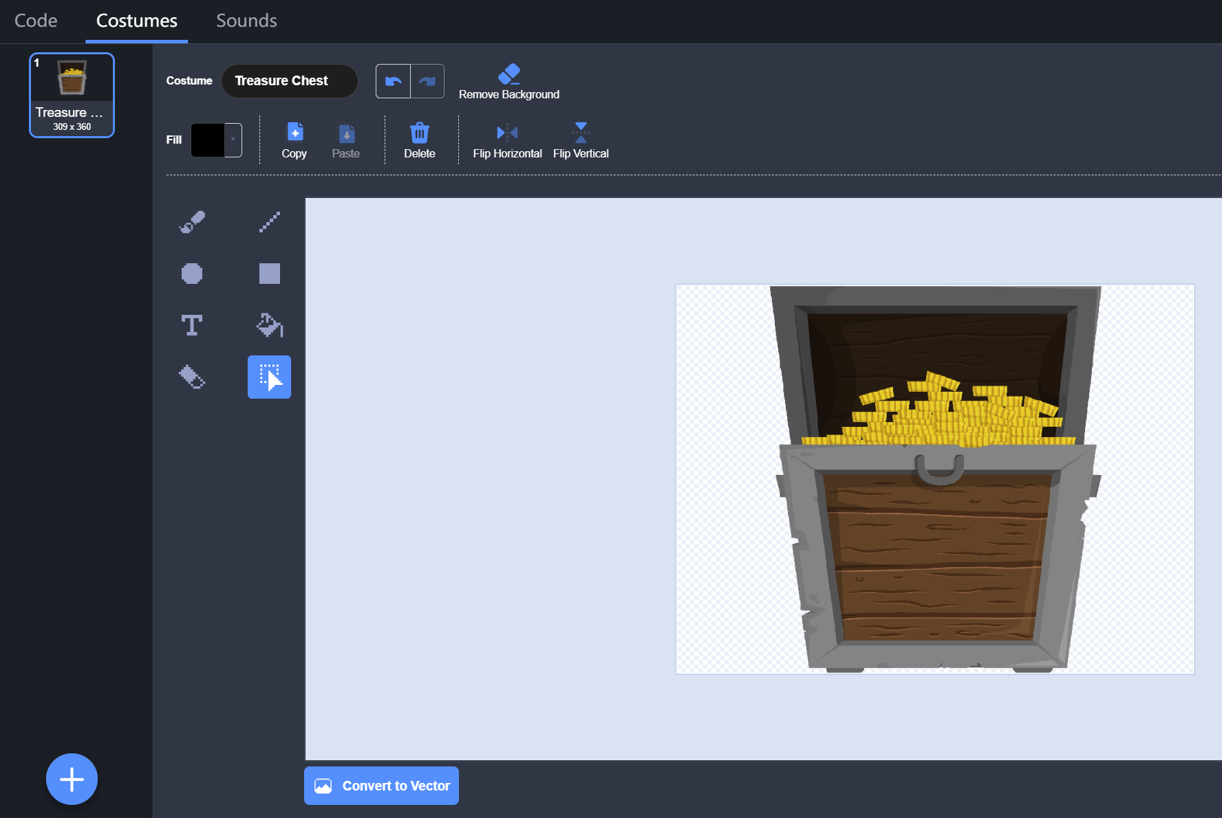

Convert To Vector

Slide 18
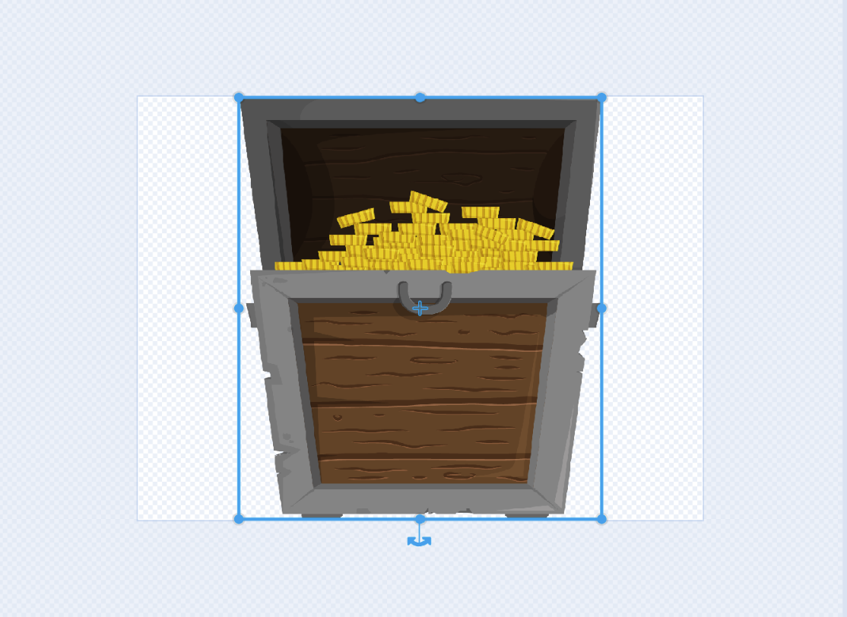
Make Treasure Smaller

Slide 19
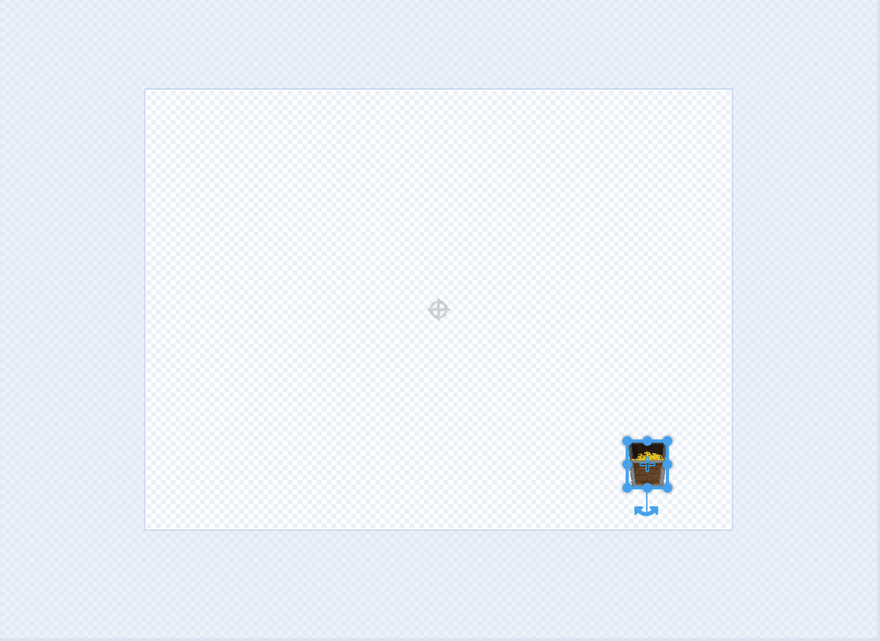
Make Treasure Smaller

Slide 20
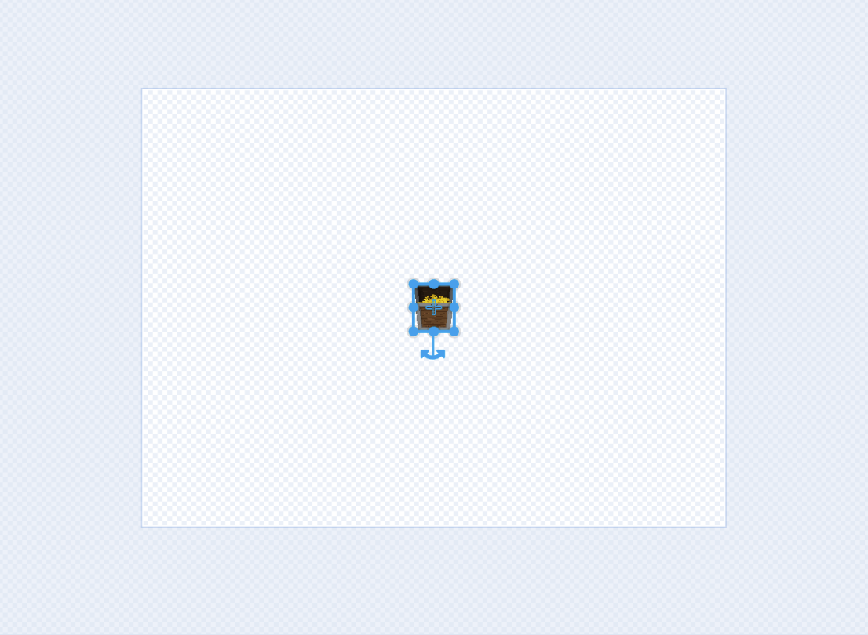
Center Treasure

Slide 21

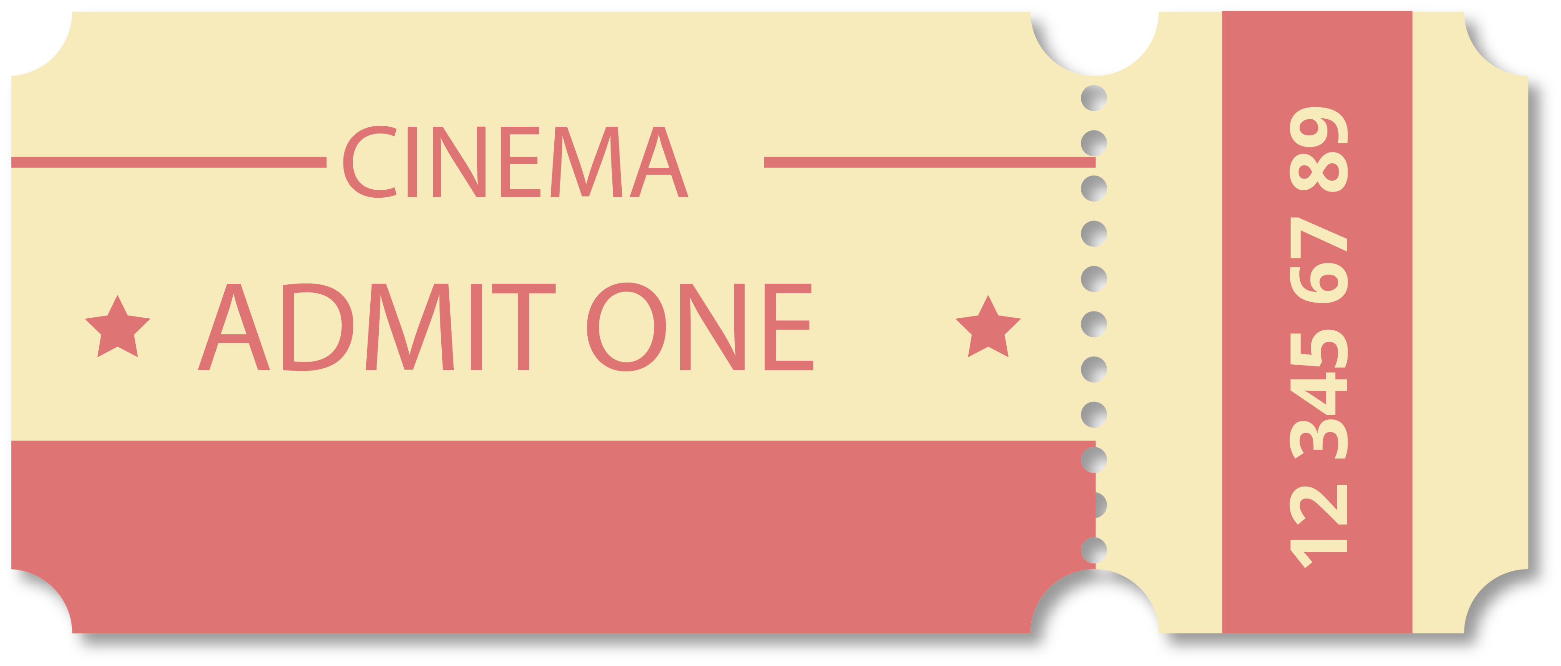

Coordinate System
ROW 3 COLUMN 4
②
①
④
③
⑥
⑤
①
②
③
④
⑤
⑥

Slide 22
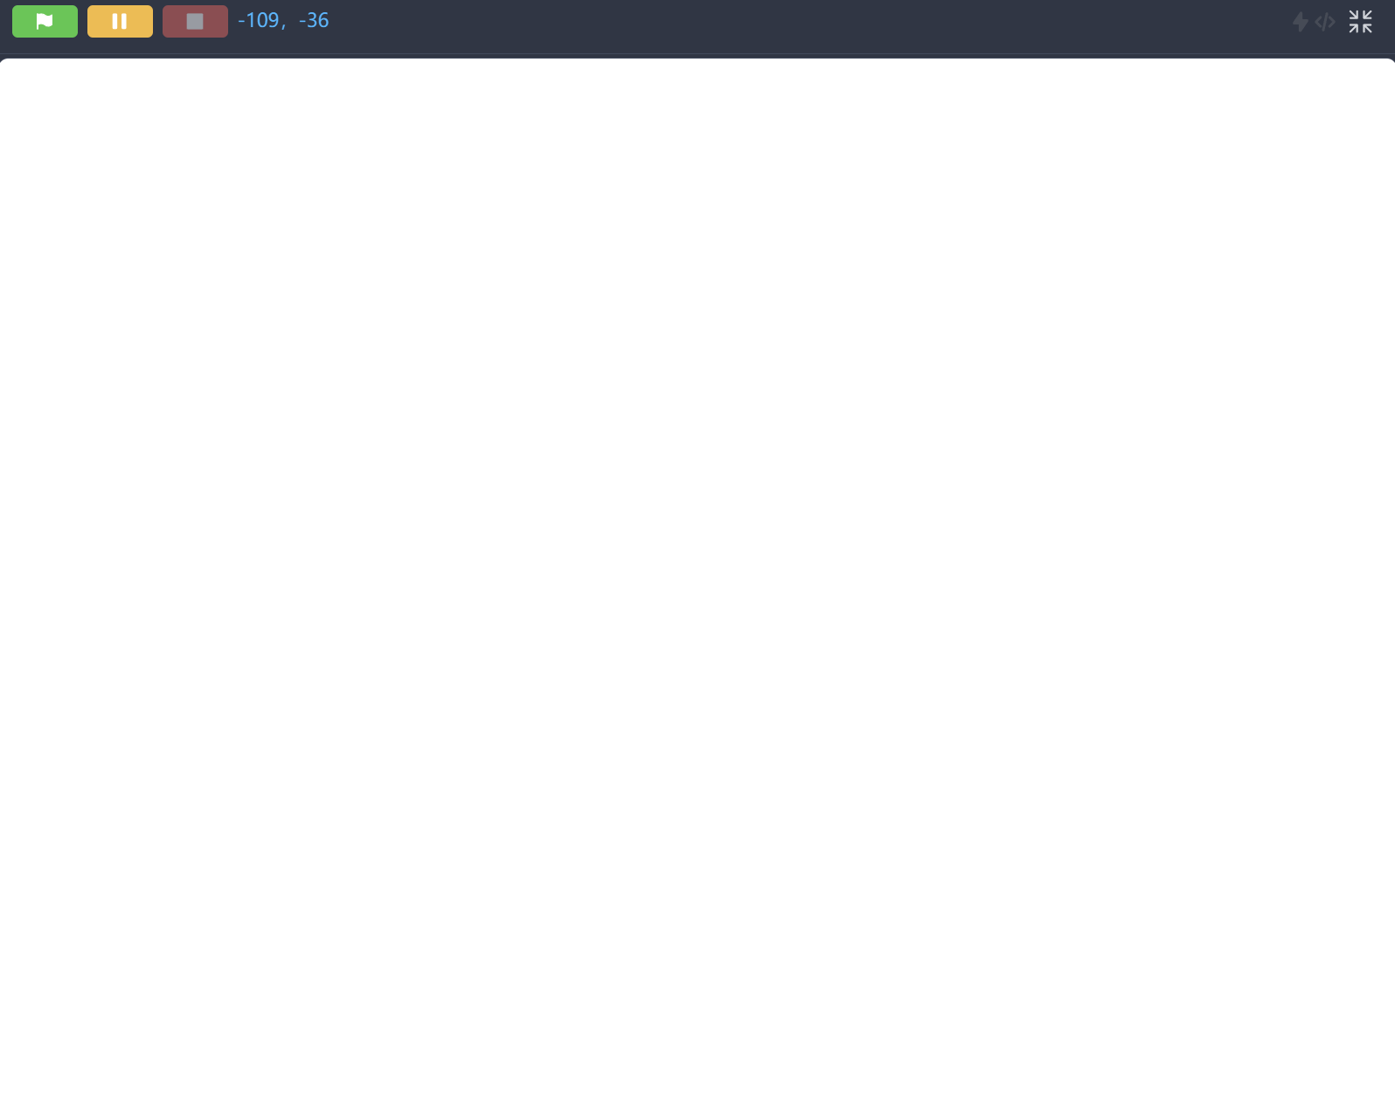
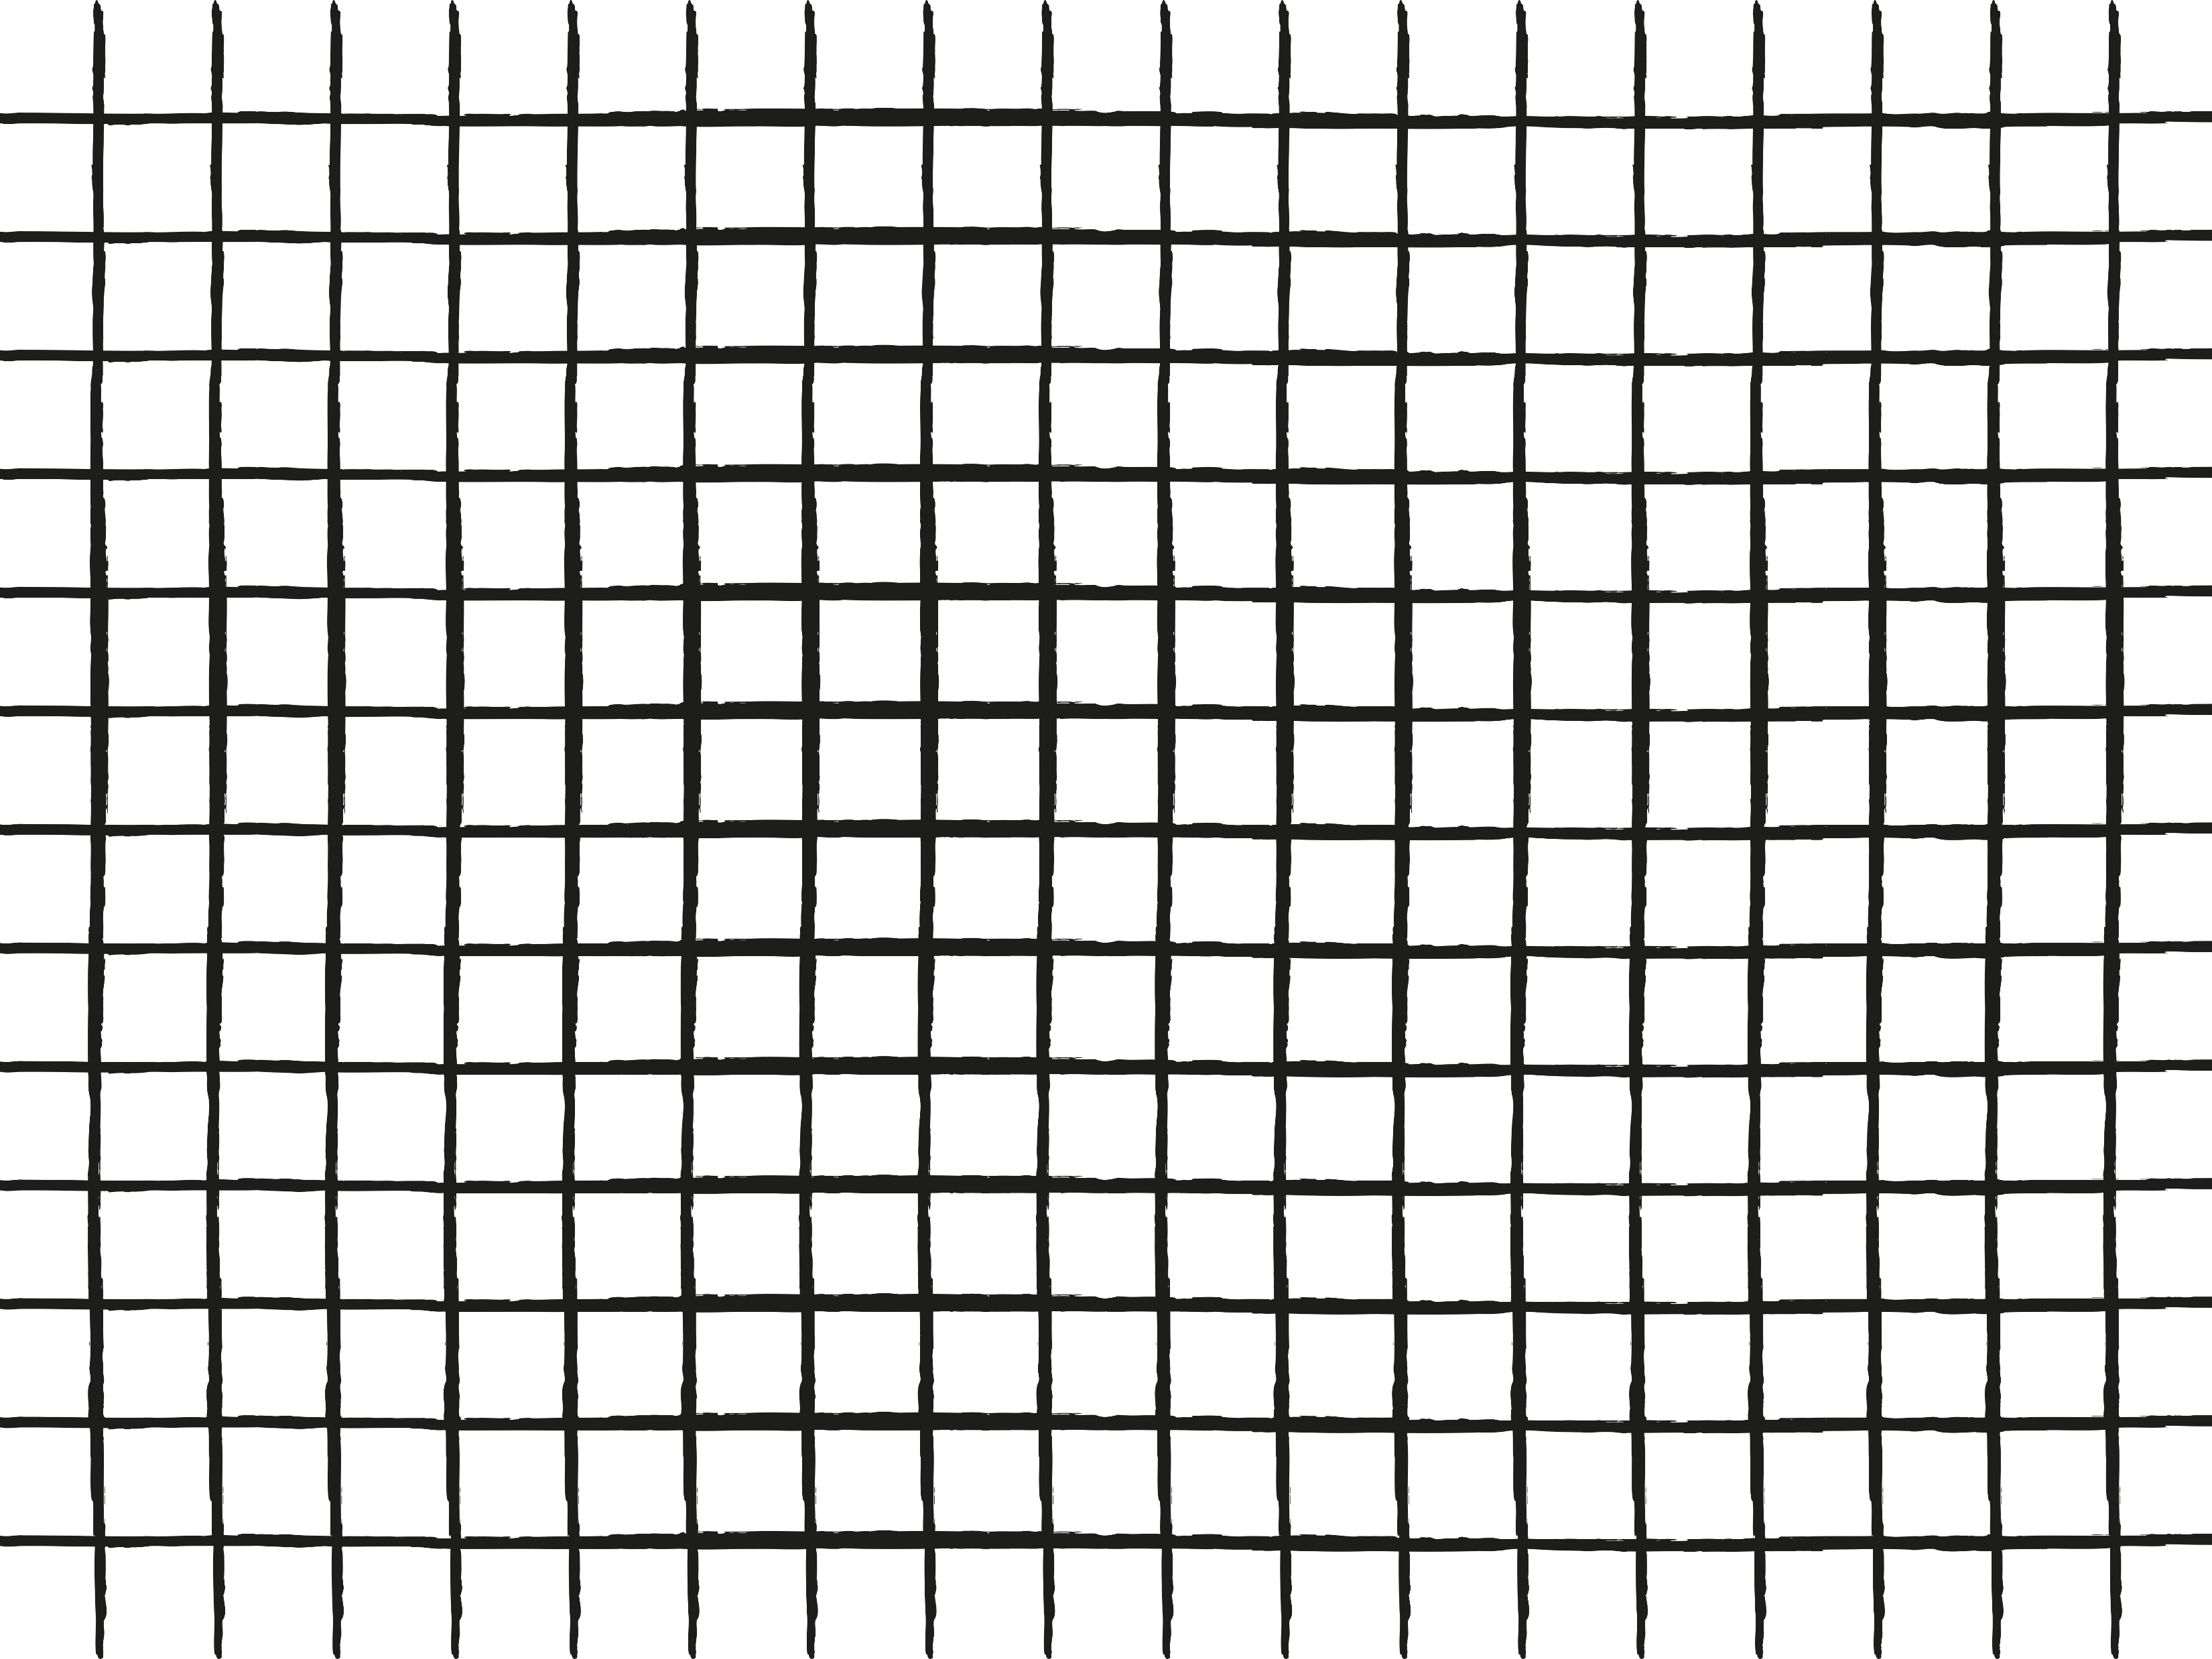
Coordinate System
360 x 480 = 172800 Seats!!!
360 Rows
480 Columns

Slide 23
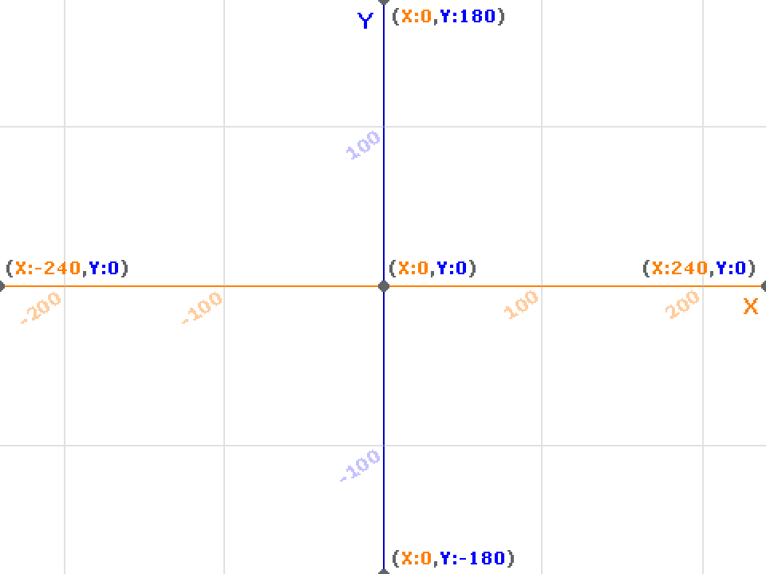
Coordinate System
X Axis
Y Axis

Slide 24
Coordinate System

Slide 25

Positive and Negative
Positive: 1, 2, 3 …
Sea Level: 0
Negative: -1, -2, -3 …

Slide 26
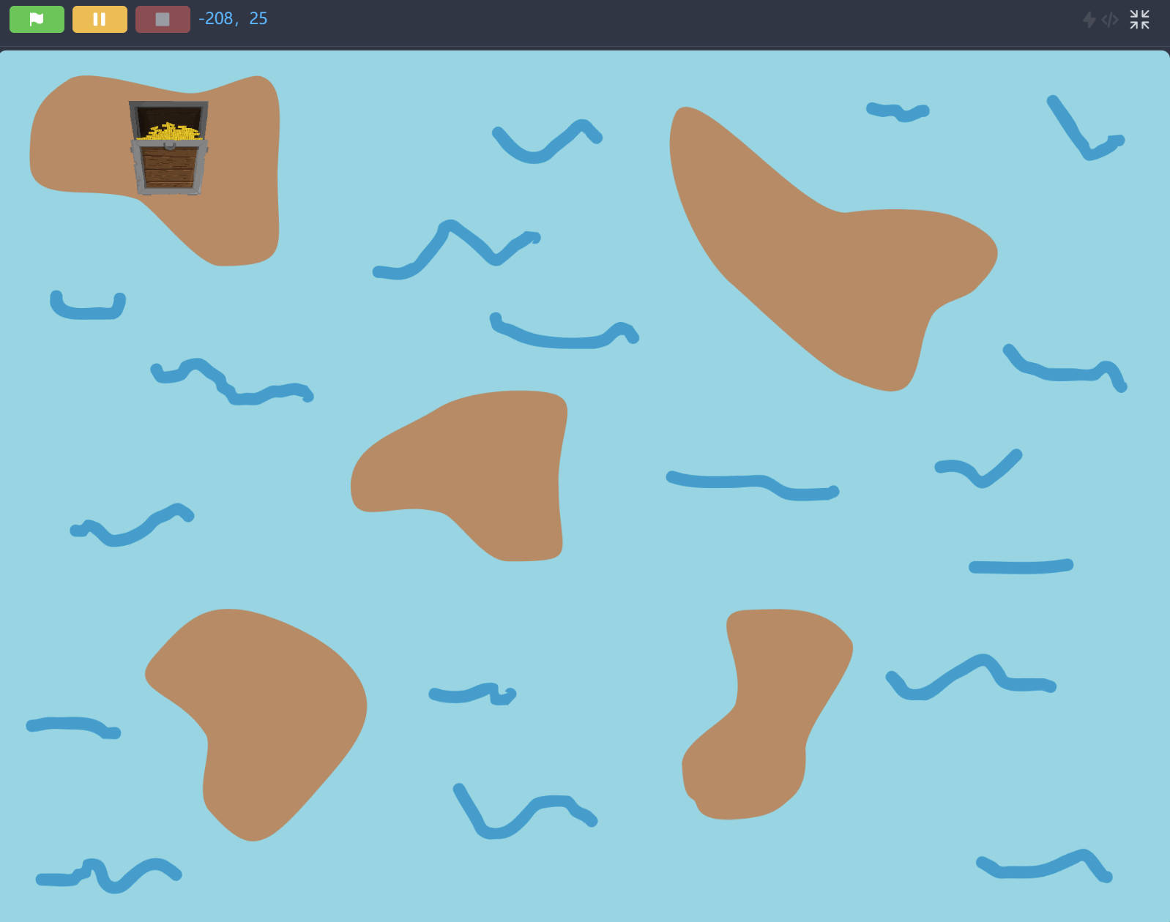

Treasure Location

Slide 27
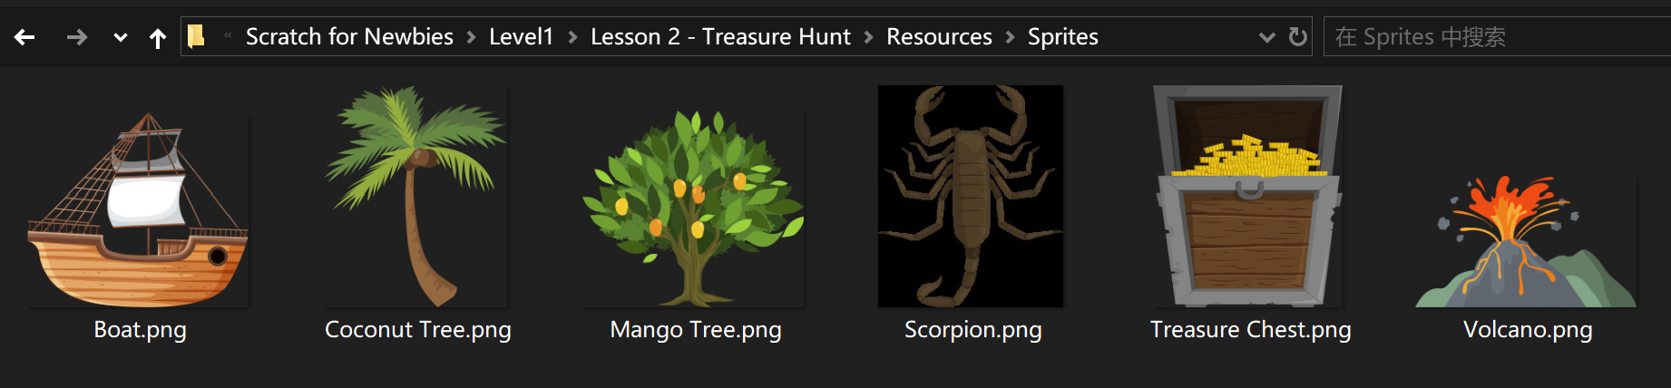
Upload Boat Sprite

Slide 28
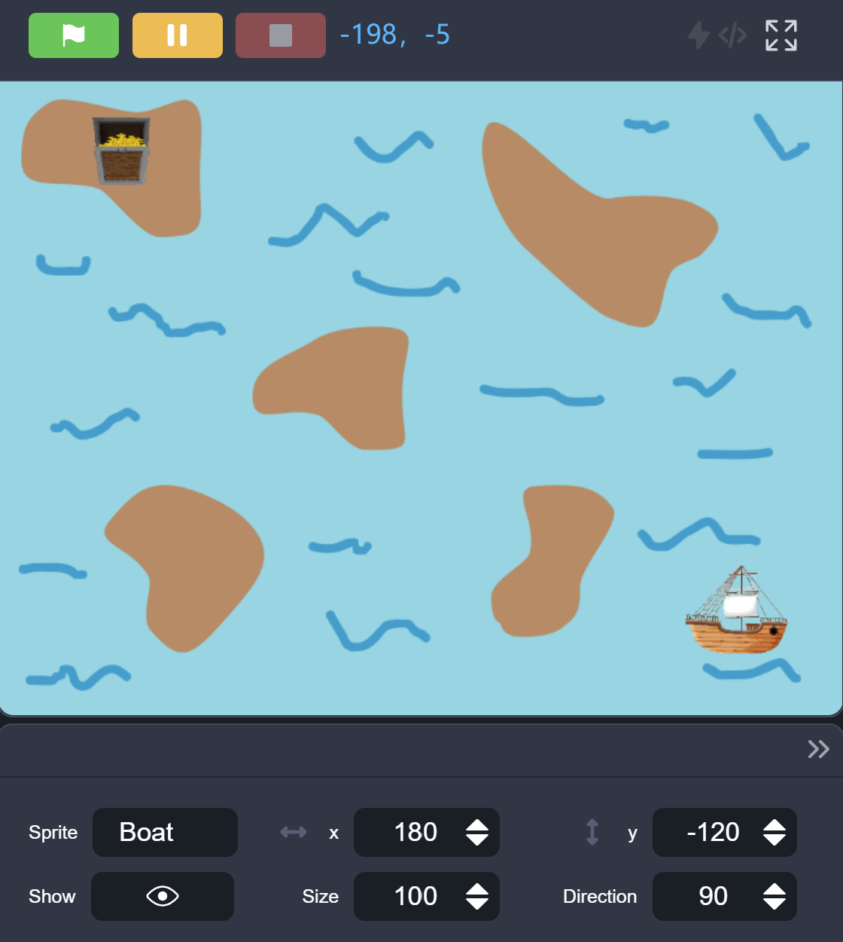
Upload Boat Sprite

Slide 29
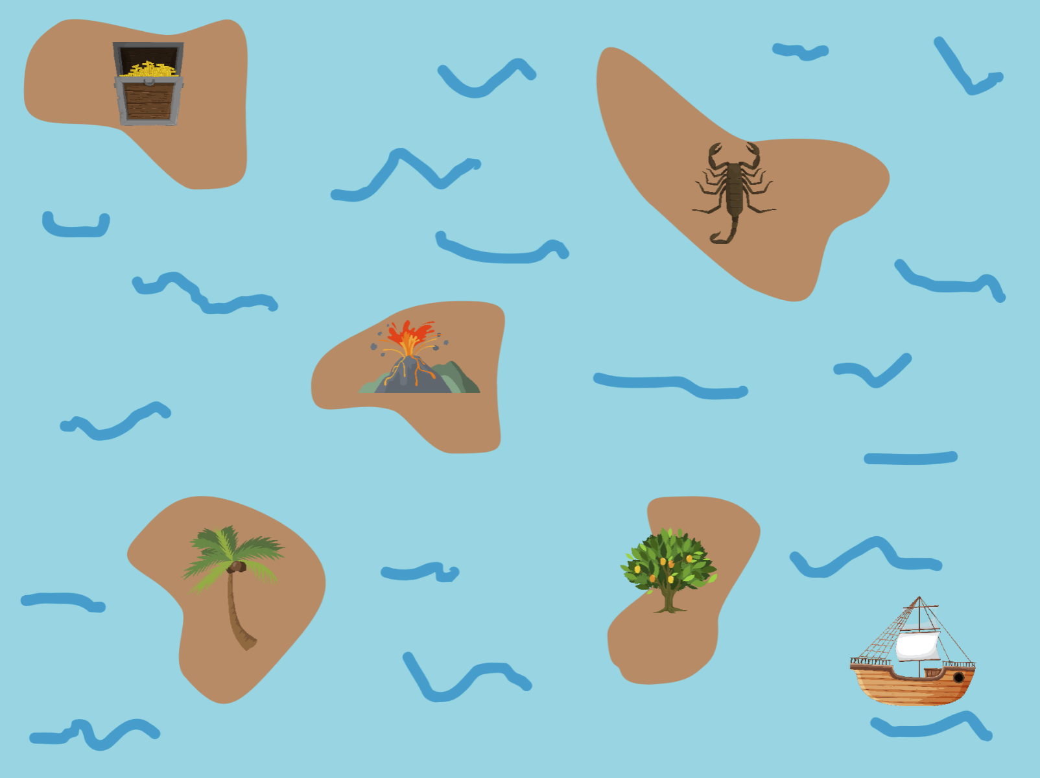
All Islands

Slide 30
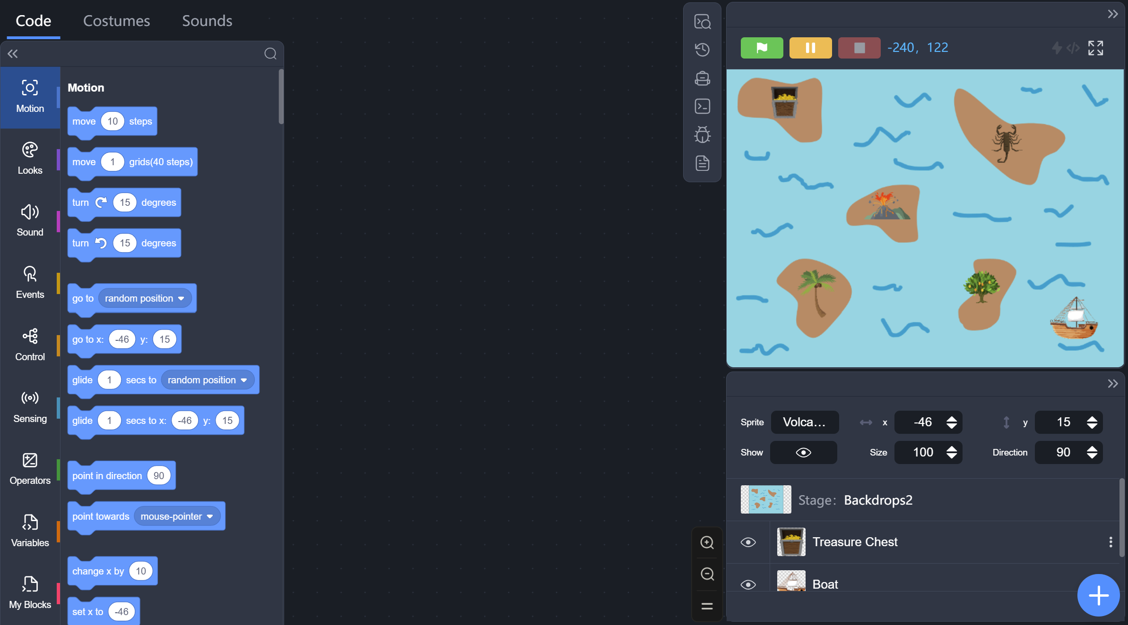
Development Mode
You can drag and move spites around on the stage

Slide 31
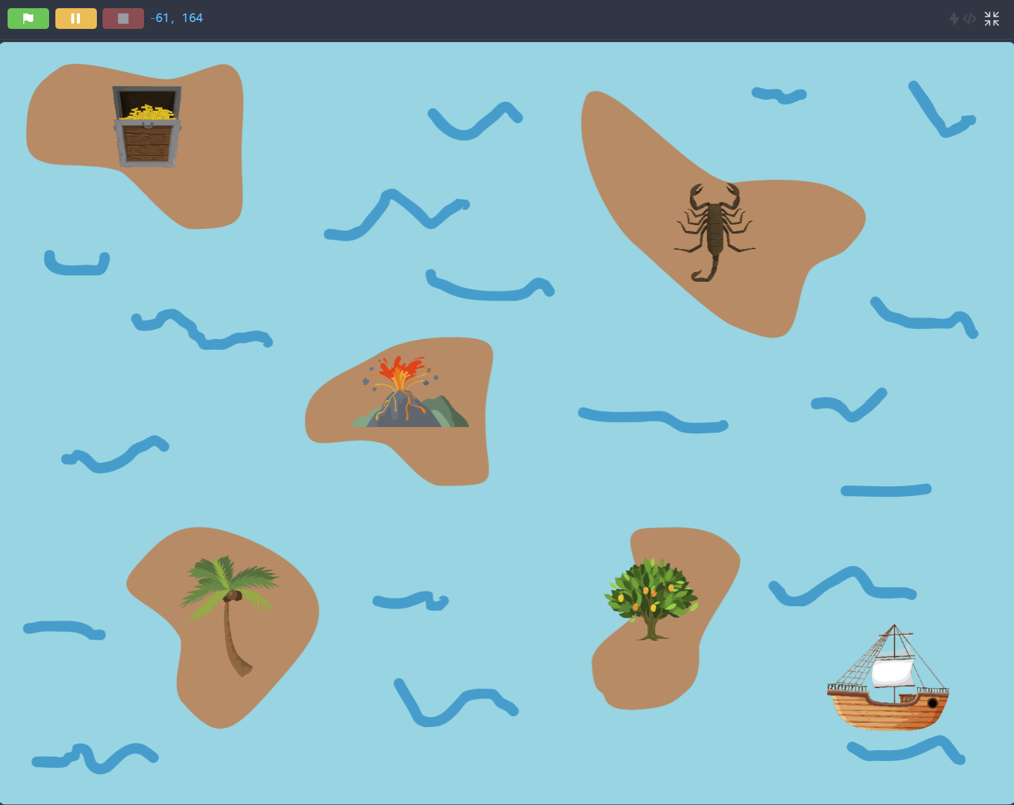
Execution Mode
You can only watch without moving sprites on the stage

Slide 32

GO To Block
X coordinate
Y coordinate

Slide 33
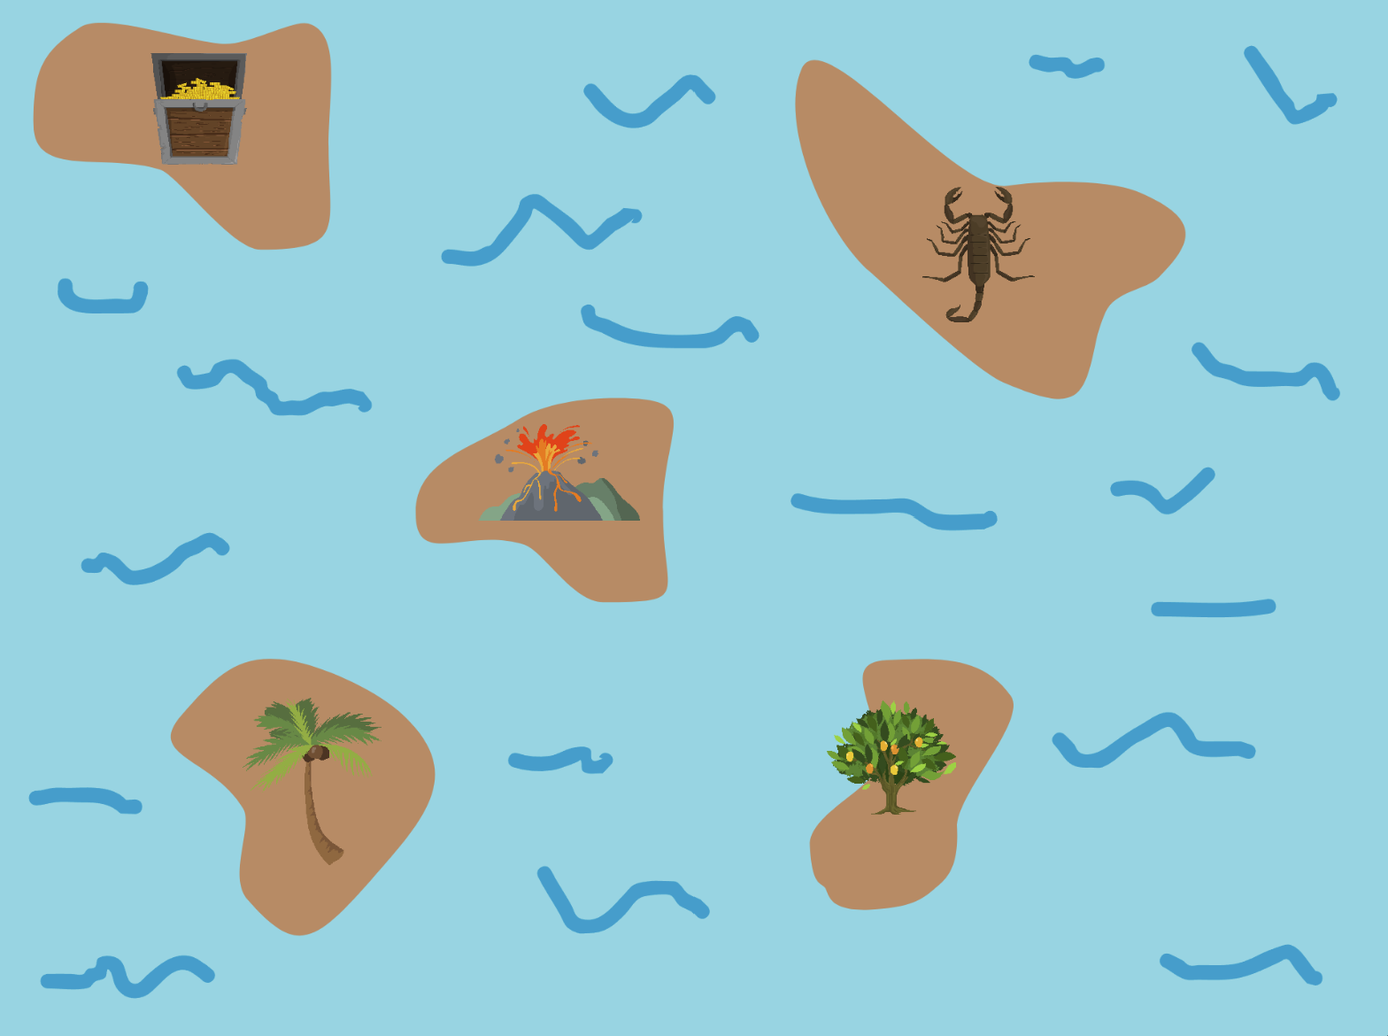

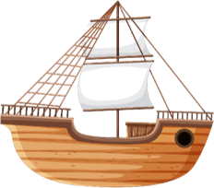
GO To Mango Island
x: 70 y: -90

Slide 34

“Go” Button
Go!!!!!!

Slide 35

When Flag Clicked

Slide 36

GO To Coconut Island
x: -140 y: -90
Too fast!!!

Slide 37

GO To Coconut Island
I’ll wait for 1 second
x: -140 y: -90
Wait!!!

Slide 38

Go back
I’ll wait for 1 second

Slide 39

Go To Treasure
x: -140
y: 120
I’ll wait for 1 second
I’ll wait for 1 second
I’ll wait for 1 second

Slide 40
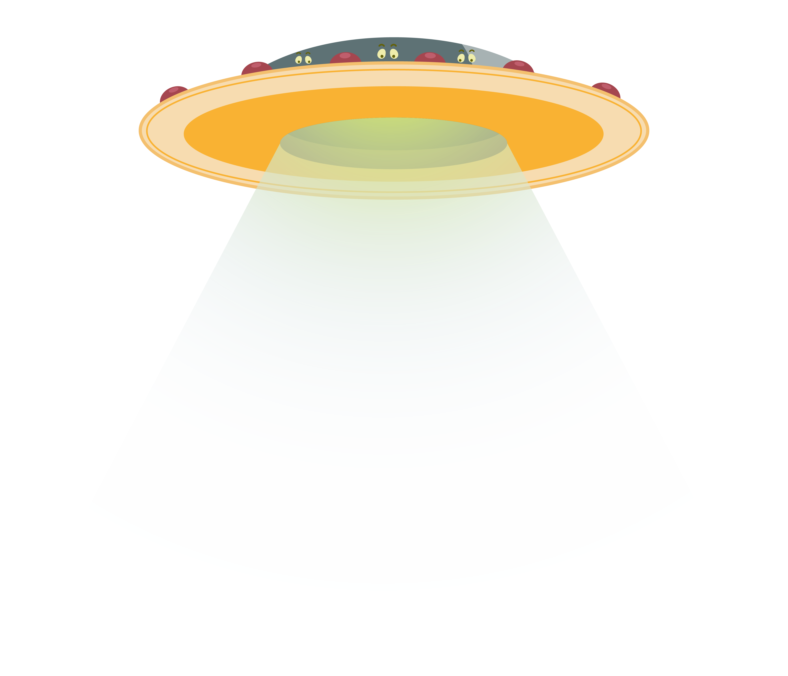


Teleportation

Slide 41

Glide

Slide 42

Glide Block
X coordinate
Duration
Y coordinate

Slide 43
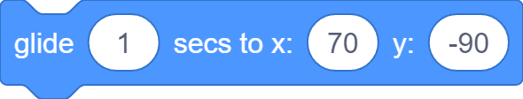
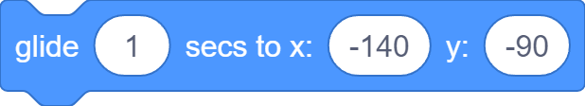

Glide To Treasure
x: -140
y: 120
I’ll wait for 1 second
I’ll wait for 1 second
I’ll wait for 1 second

Slide 44

Head for Disaster
Ouch!!!

Slide 45

Glide to Sprite Block
Where to glide to?
Duration

Slide 46
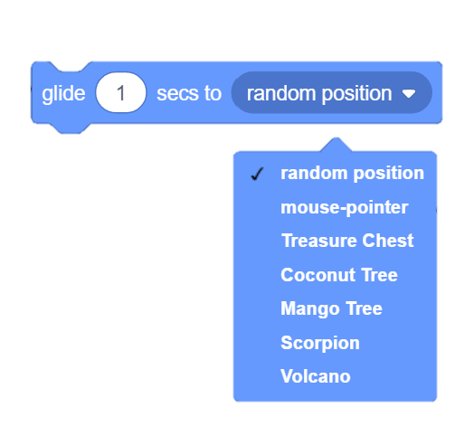
Glide to Sprite Block
Glide to random position, mouse pointer or any other sprites

Slide 47



Head for Disaster

Slide 48
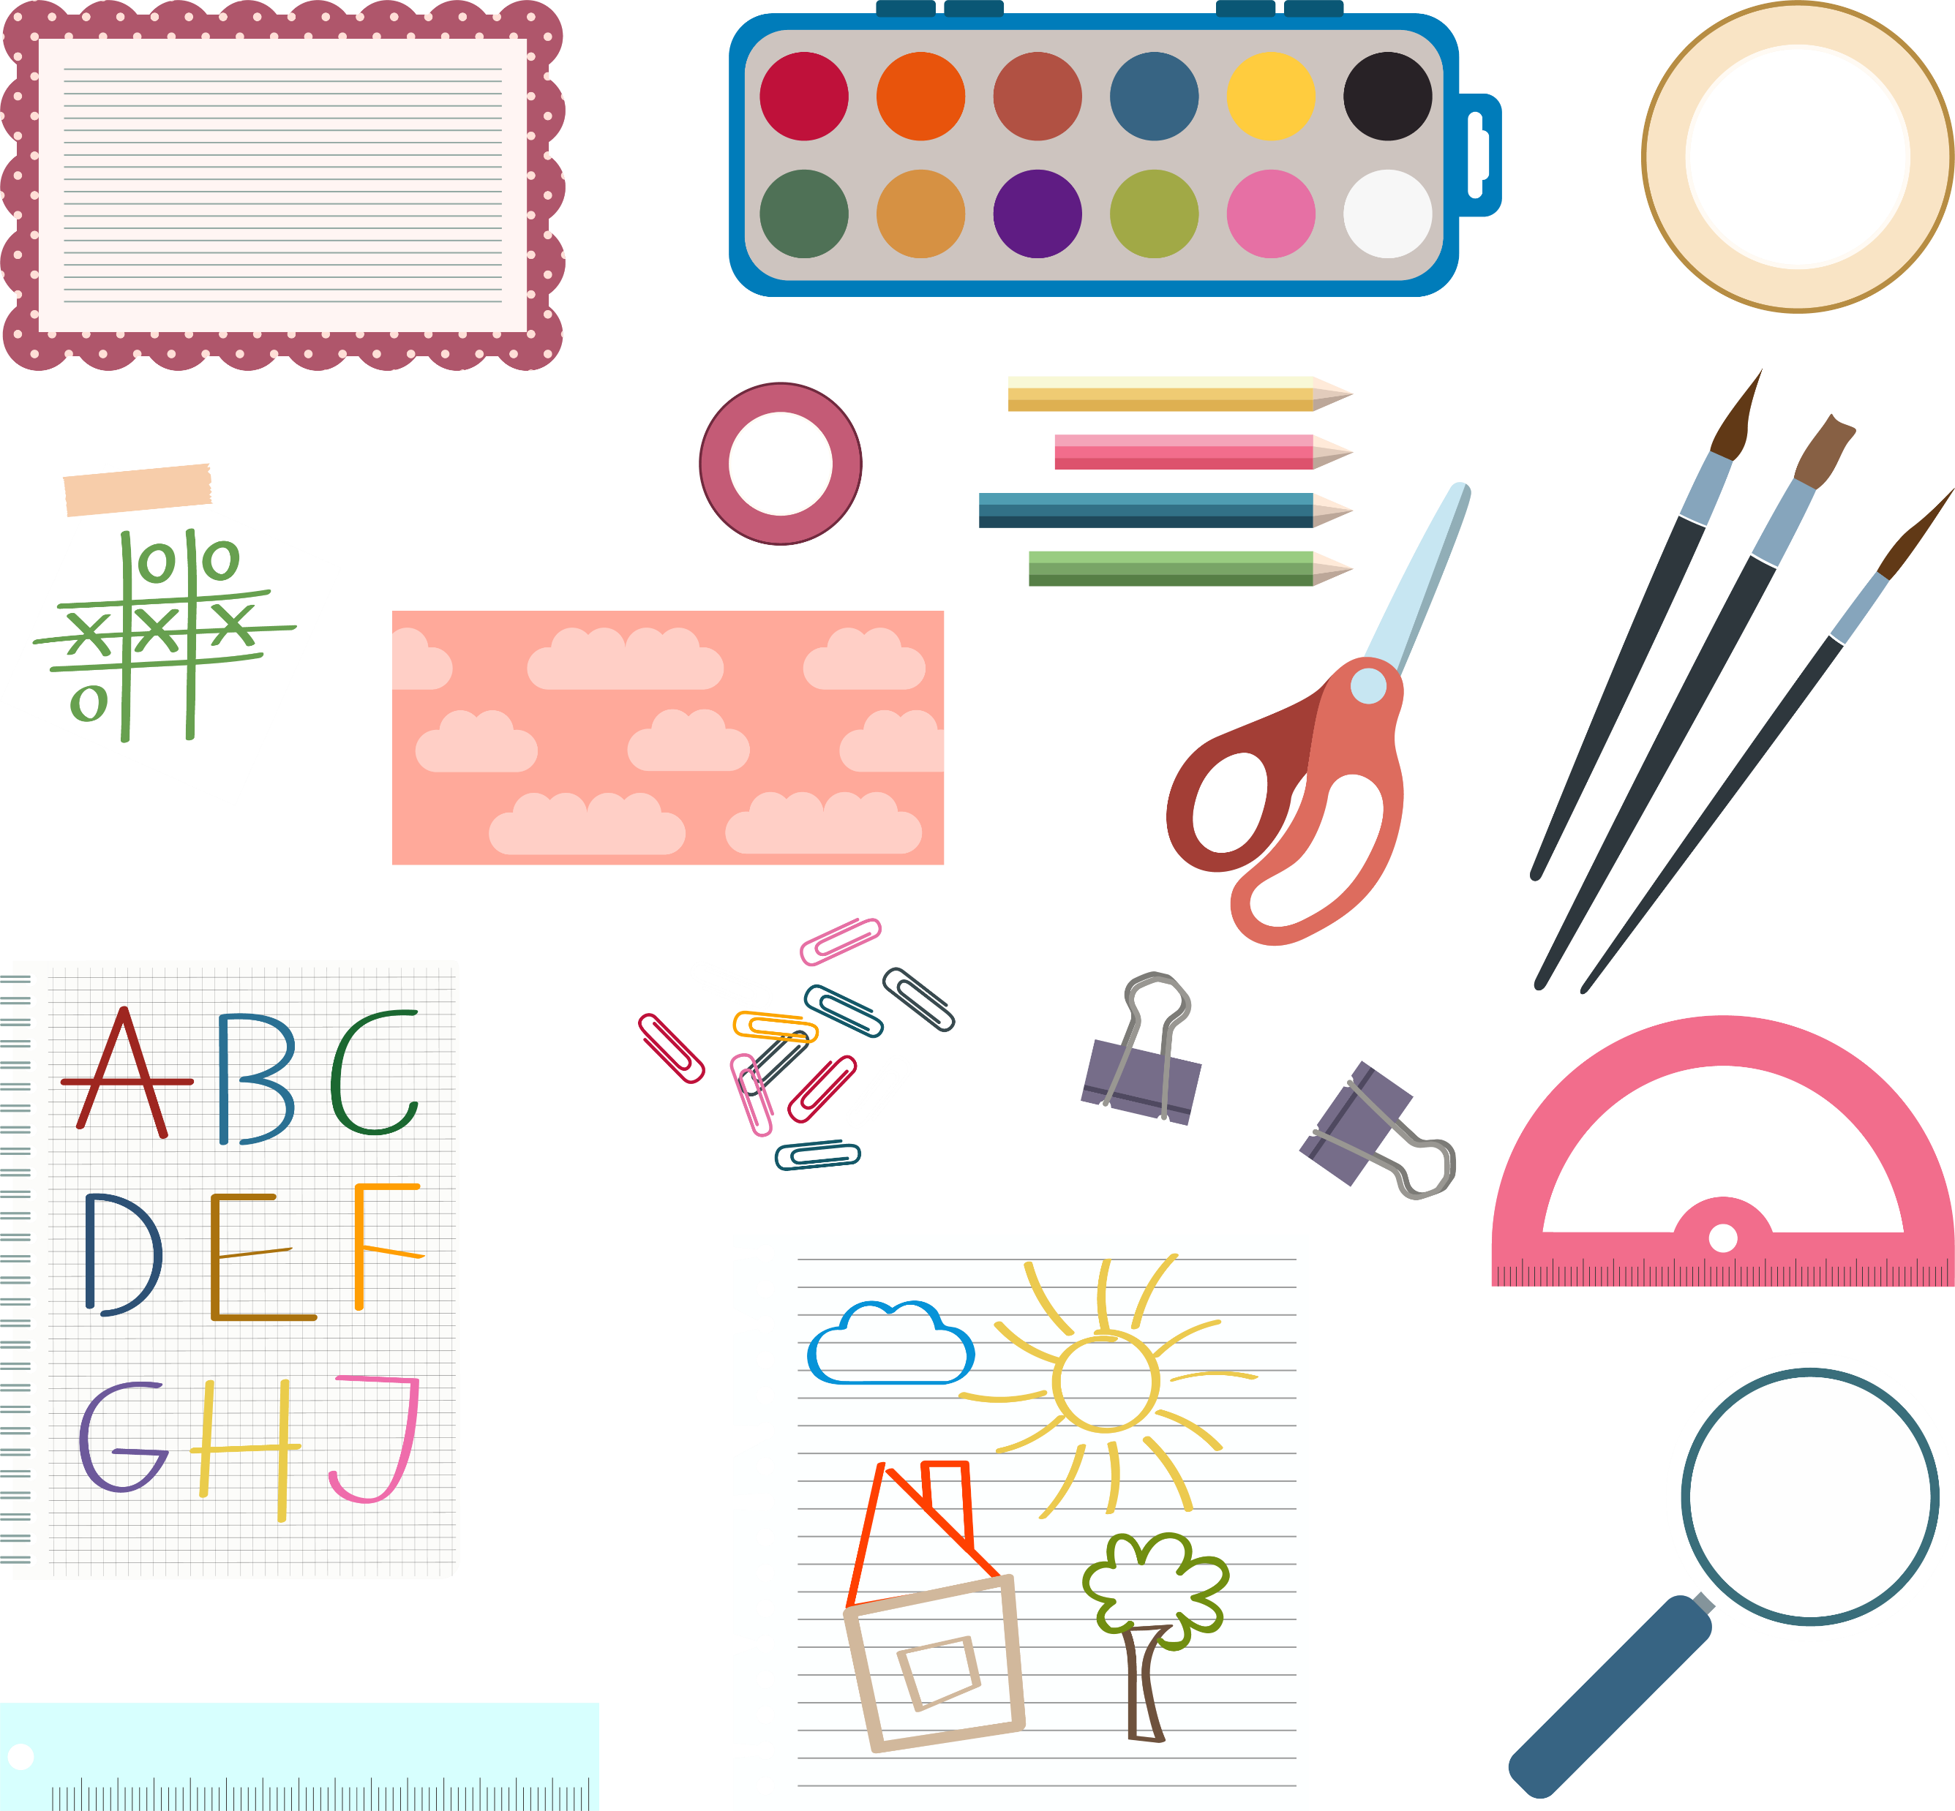
Drawing Kit

Slide 49


Extension Library

Slide 50
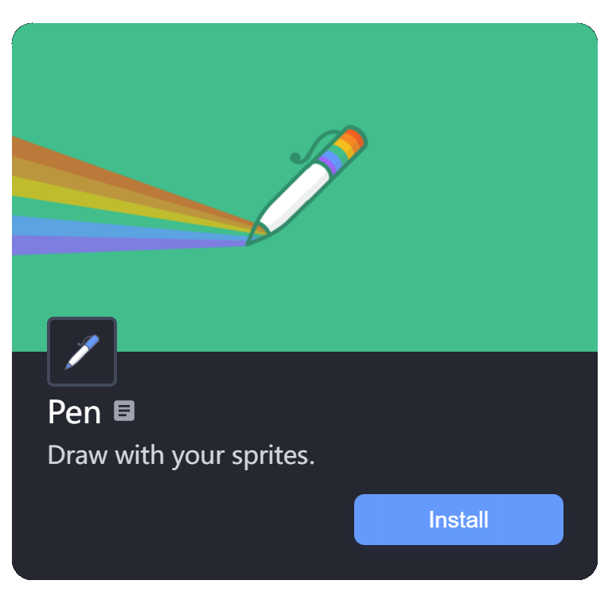
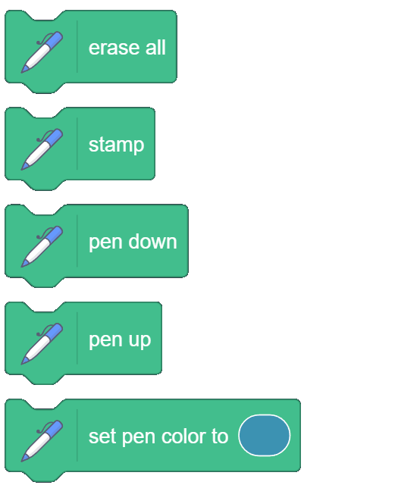
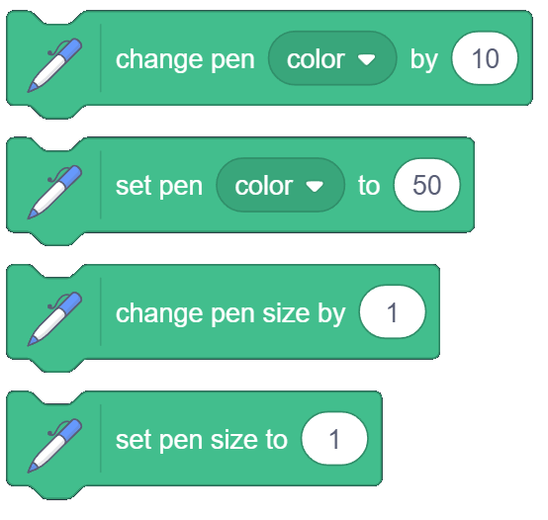
Extension Library

Slide 51


Draw Route Map

Slide 52
Draw Route Map

Slide 53

Draw Route Map

Slide 54
Draw Route Map

Slide 55


Draw Route Map
Smaller number, thinner line; bigger number, thicker line

Slide 56

Draw Route Map

Slide 57
What we learnt…
How to draw your own backdrop…

Slide 58






What we learnt…
How to upload your own sprites…

Slide 59
What we learnt…
What is a Coordinate System…

Slide 60
What we learnt…
How to move sprites…

Slide 61
What we learnt…
How to start the program…

Slide 62
What we learnt…
How sprites can draw…

Slide 63
Exercises
What if you don’t put the costume at the center of the canvas?
Try out the different drawing tools in the Backdrop Editor
Use the Costume Editor to create your own sprites
Is there other blocks that can make sprites go anywhere on the stage?

Slide 64
Exercises
How can you make all sprites go to their starting positions when program starts?
What other pen attributes can you set? Try them out!
Can you make the animation even better by adding sounds?
Create your own animation with a different theme!

Slide 65
Thank you and see you in the next lesson!

